Slide 1
2025 UNIFIED TRANSPORTATION PROGRAM AND REGIONAL 10-YEAR PLAN UPDATE
Regional Transportation Council
August 8, 2024
NCTCOG

Slide 2
BACKGROUND
Texas House Bill 20 requires that Metropolitan Planning Organizations (MPO) develop 10-Year Plans using performance-based planning and project selection methods
Includes projects funded with:
Category 2 (MPO selected)
Category 4 (TxDOT District selected)
Category 12 (Texas Transportation Commission [TTC] selected)
The Regional 10-Year Plan was originally approved by the Regional Transportation Council (RTC) in December 2016
This plan is updated annually in conjunction with the development of TxDOT’s Unified Transportation Program (UTP)

Slide 3
PRINCIPLES FOR THE DEVELOPMENT OF THE REGIONAL 10-YEAR PLAN
Project should be included in the Metropolitan Transportation Plan
Focus on “system” versus new, stand-alone projects
Fully fund existing projects before funding new projects (with a focus on projects letting in the next 2-3 years)
Ensure equity of county allocations
Maintain toll lanes/toll managed lanes on selected corridors
Re-fund previously unfunded projects, when possible
Ensure all RTC projects are approved in 2025 UTP (including “placeholders”)
Projects must be scored and should have a score sufficient to qualify for funding

Slide 4
REGIONAL FUNDING ALLOCATIONS FOR 2017-2025 UTPs
Funding Category* | 2017 UTP | 2018 UTP | 2019 UTP | 2020 UTP | 2021 UTP | 2022 UTP | 2023 UTP | 2024 UTP | 2025 UTP (Proposed)
Category 2 | $3.784 | $3.607 | $3.832 | $3.516 | $2.913 | $2.931 | $3.205 | $3.470 | $3.448
Category 4 | $0.830 | $1.553 | $1.637 | $1.537 | $1.340 | $1.348 | $1.593 | $2.341 | $2.626
Category 12 | $0.812 | $2.130 | $1.395 | $3.041 | $3.089 | $2.601 | $3.132 | $4.082 | $3.626
Total Allocation | $5.426 | $7.290 | $6.864 | $8.094 | $7.342 | $6.880 | $7.930 | $9.893 | $9.700

Slide 5
PROJECT PROGRESS SINCE THE 2017 UTP
Project Status | Number of Projects | Total UTP Funding
Completed | 30 | $831,018,974
Under Construction | 94 | $7,531,751,550
Future Projects | 152 | $8,938,420,916
Total | 276 | $17,301,191,440

Slide 6
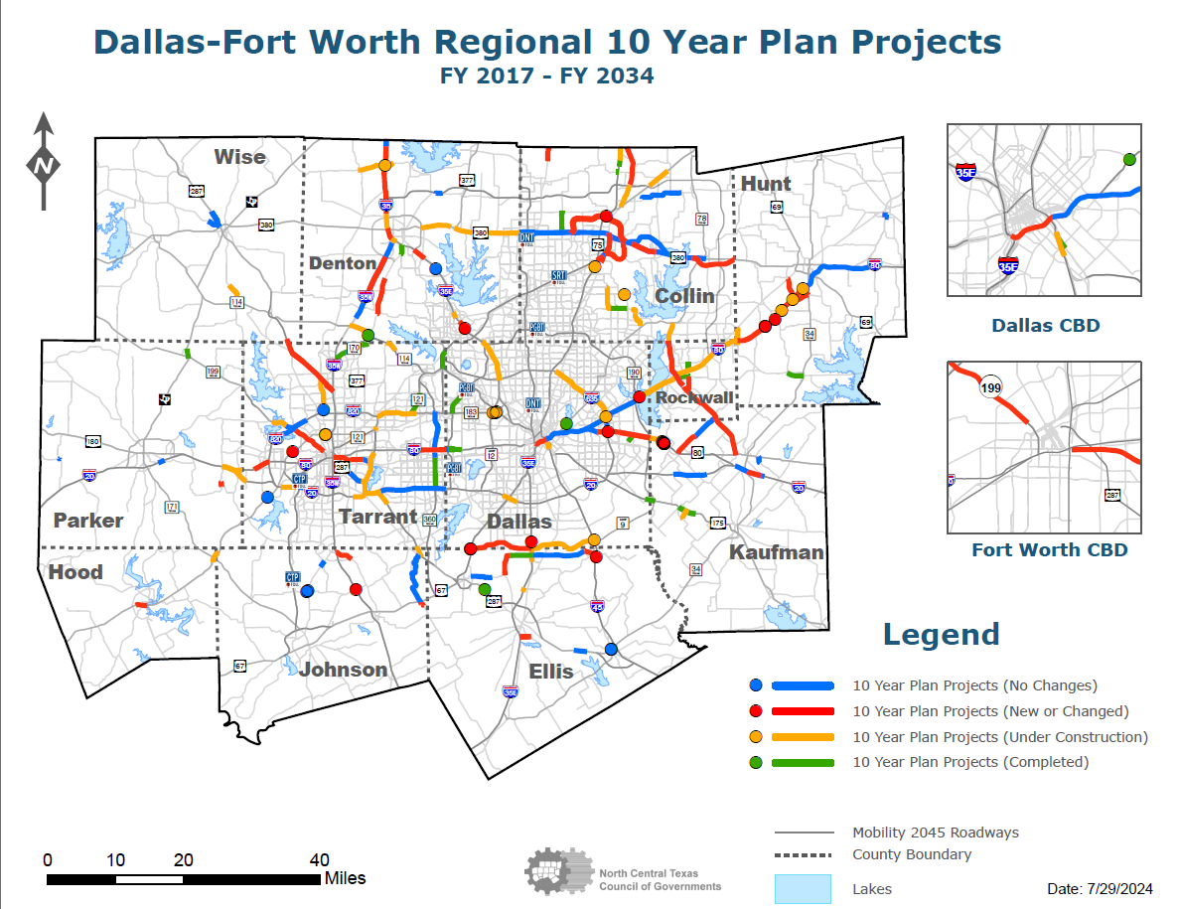

Slide 7
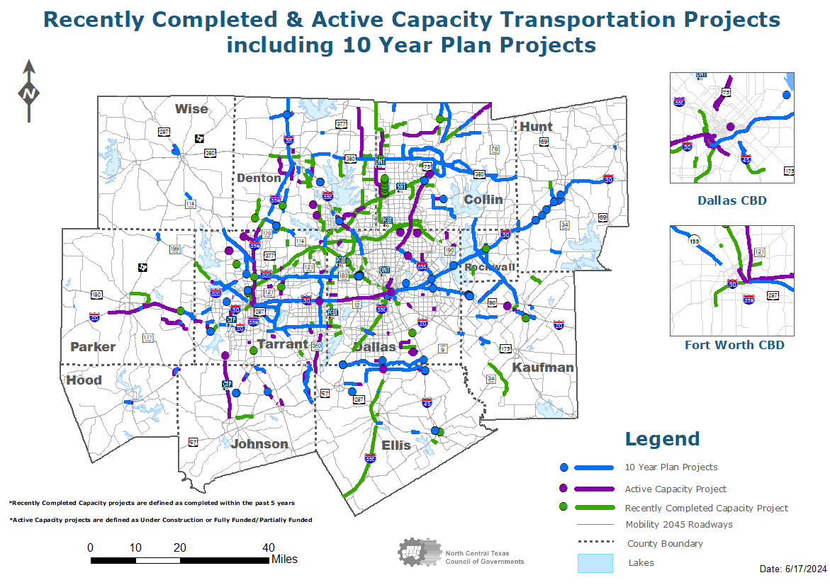

Slide 8
ACTION REQUESTED
RTC approval of:
The Regional 10-Year Plan project listing, including the proposed changes on the “Planned Projects” and “Let or Completed Project” listings
Administratively amending the Transportation Improvement Program (TIP)/Statewide Transportation Improvement Program (STIP) and other planning/administrative documents as needed to incorporate these changes

Slide 9
TIMELINE/ACTION
MEETING/TASK | DATE
Funding Targets Received | January 30, 2024
Initial draft list due to TxDOT | February 16, 2024
STTC Information | June 28, 2024
RTC Information | July 11, 2024
Public Involvement | July 2024
STTC Action | July 26, 2024
RTC Action | August 8, 2024
TxDOT Public Involvement for 2025 UTP | July and August 2024
Anticipated TTC Approval of 2025 UTP | August 2024

Slide 10
CONTACT/QUESTIONS?
Christie J. Gotti
Senior Program Manager
Ph: (817) 608-2338
cgotti@nctcog.org
Brian Dell
Program Manager
Ph: (817) 704-5694
bdell@nctcog.org
Cody Derrick
Senior Transportation Planner
Ph: (817) 608-2391
cderrick@nctcog.org
Dylan Niles
Transportation Planner I
Ph: (682) 433-0512
dniles@nctcog.org

