Slide 1
Public Works Standard Drawings Subcommittee Meeting
Monday September 24, 2018
Swing Space – Large Conference Room

Slide 2
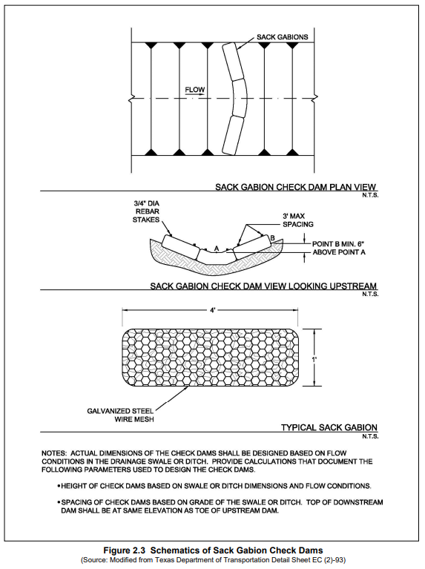
AS PROVIDED IN PLANS BY OWNER OR OWNER’S REPRESENTATIVE
Standard Specification Reference
Date | Standard Drawing No. New Drawing
AND SPACING

Slide 3
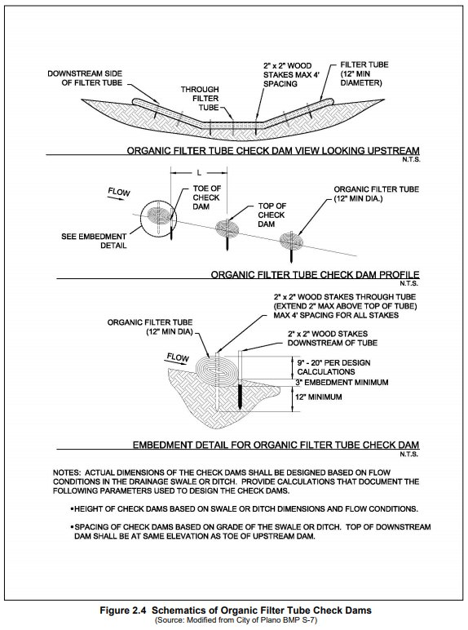
Standard Specification Reference
Date | Standard Drawing No. New Drawing

Slide 4
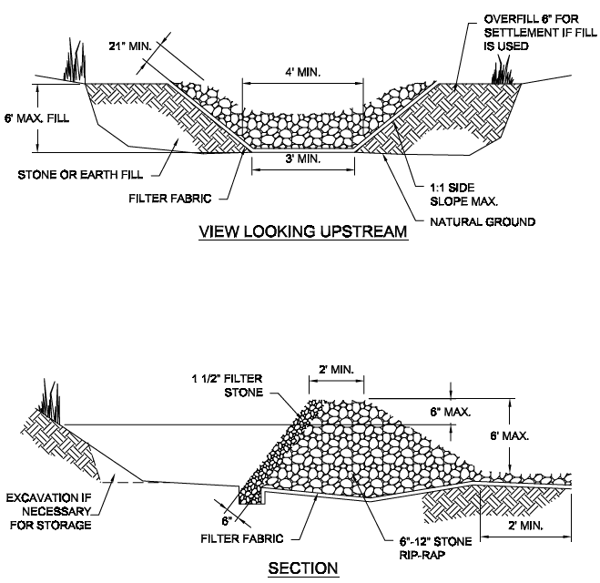
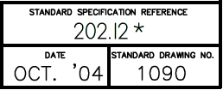
Replace 1090A with iSWM 3.30 and 3.31

Slide 5
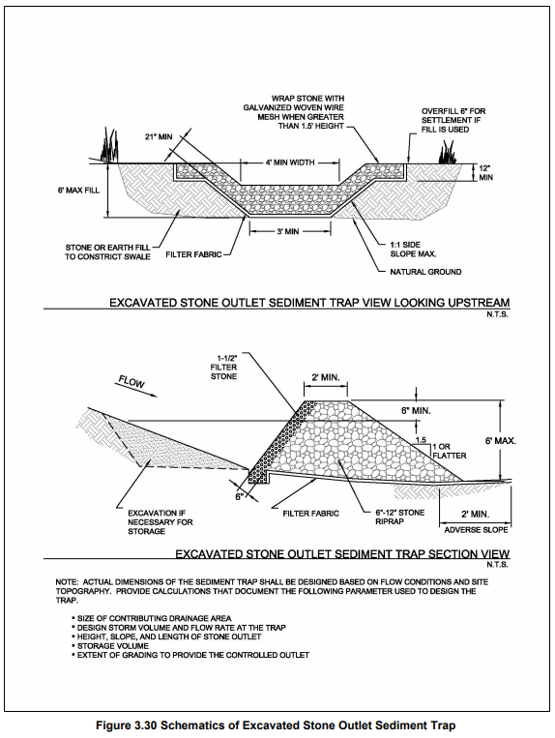
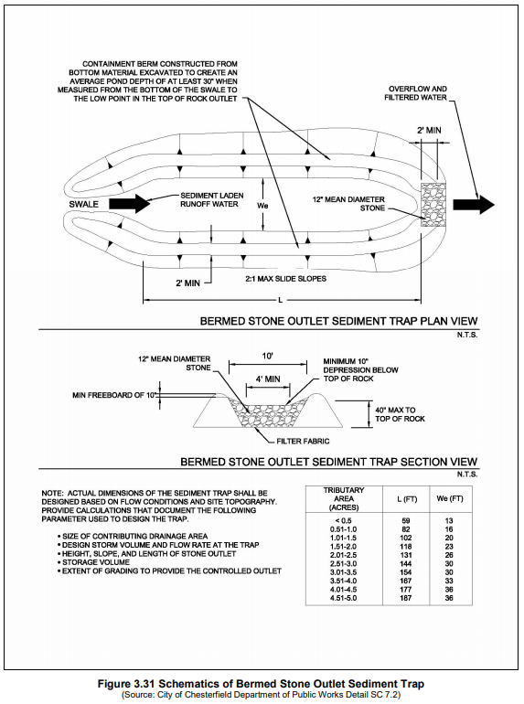
Standard Specification Reference 202.12 *
Date | Standard Drawing No. 1090A
Standard Specification Reference 202.12 *
Date | Standard Drawing No. 1090B

Slide 6
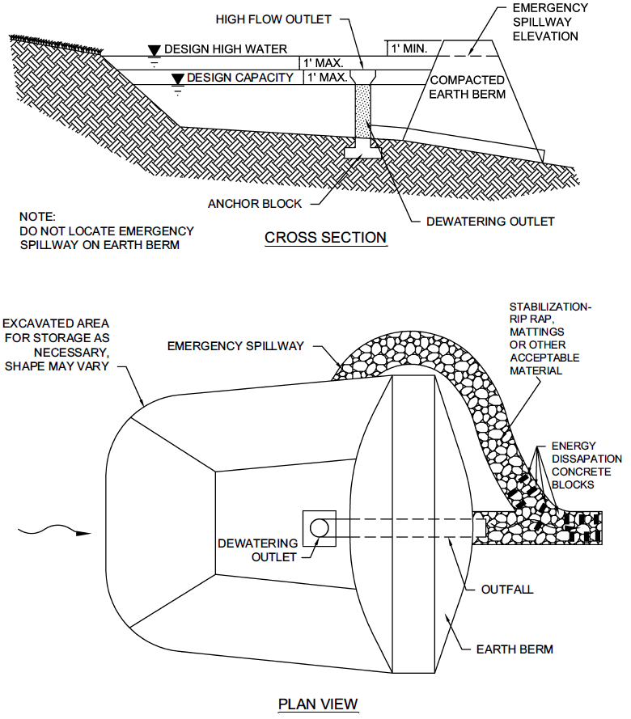
Replace 1100 with iSWM Figure 3.20

Slide 7
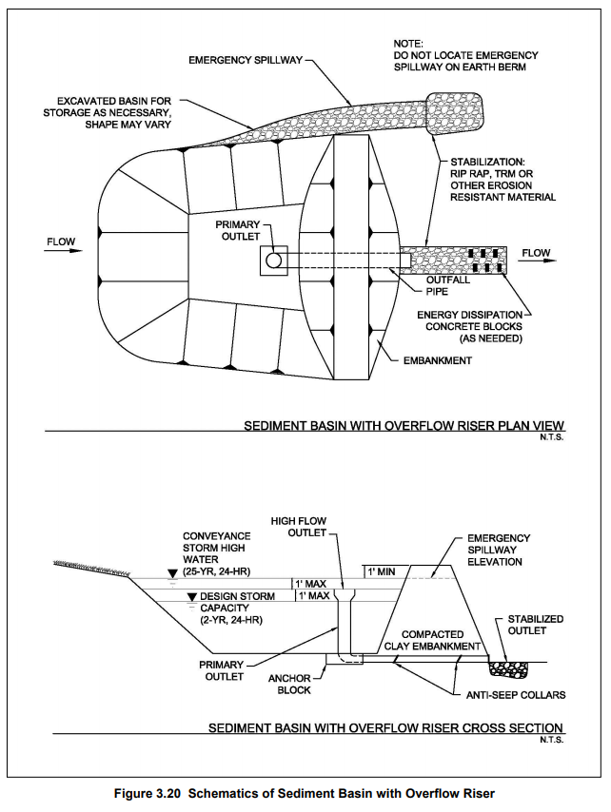
Standard Specification Reference
Date | Standard Drawing No. 1100

Slide 8
Additional Edits
Drawing Titles

Slide 9
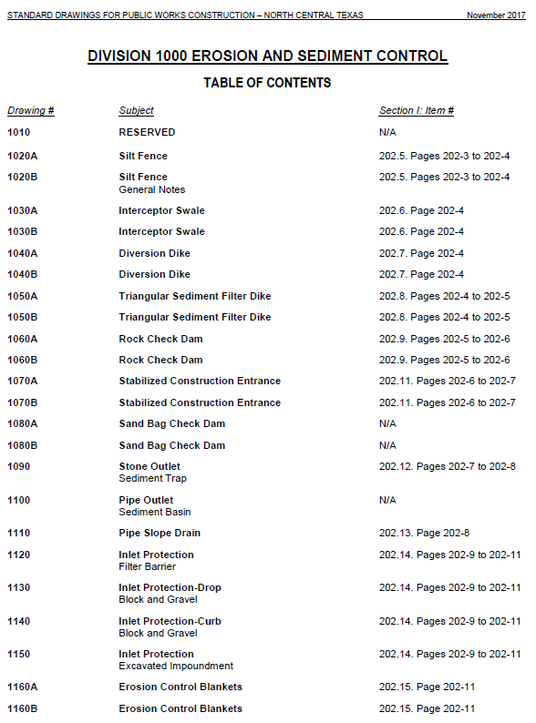
Exit
Exit
- Area
- Area

Slide 10
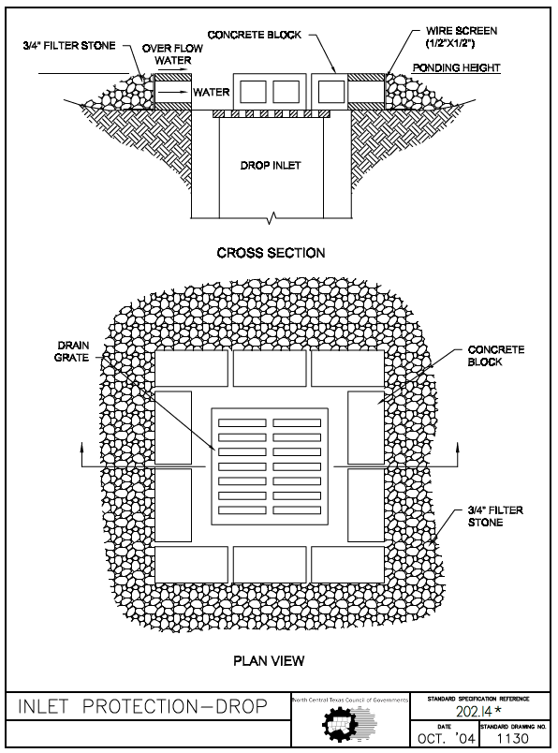
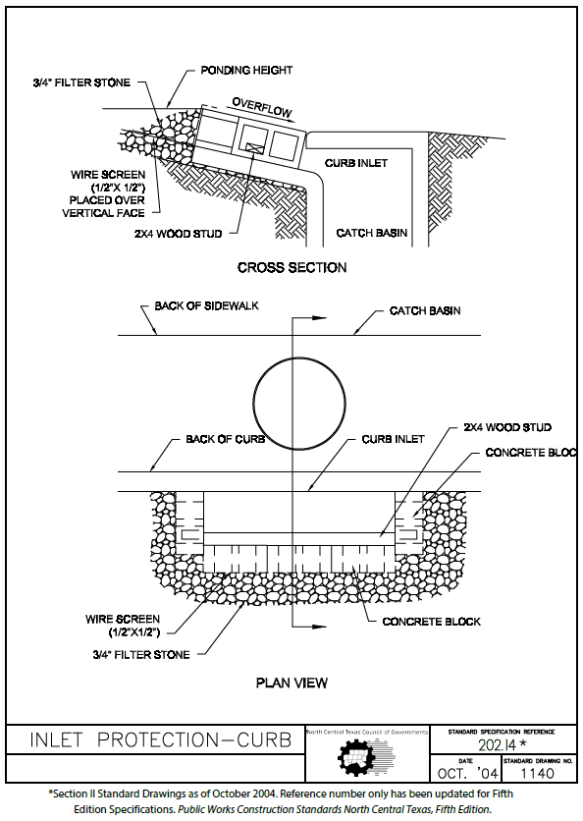
BLOCK AND GRAVEL
BLOCK AND GRAVEL

Slide 11
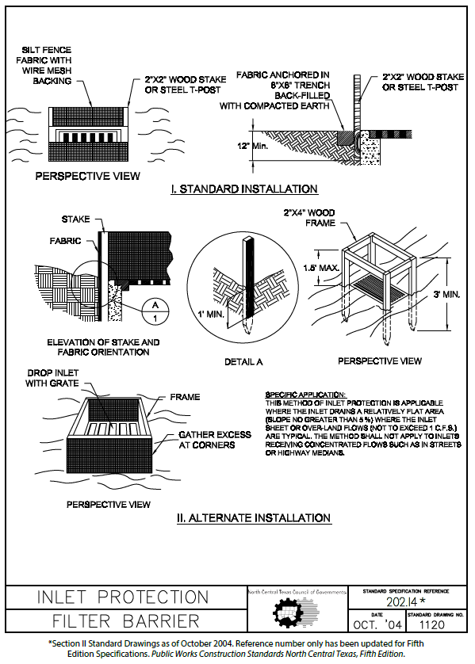
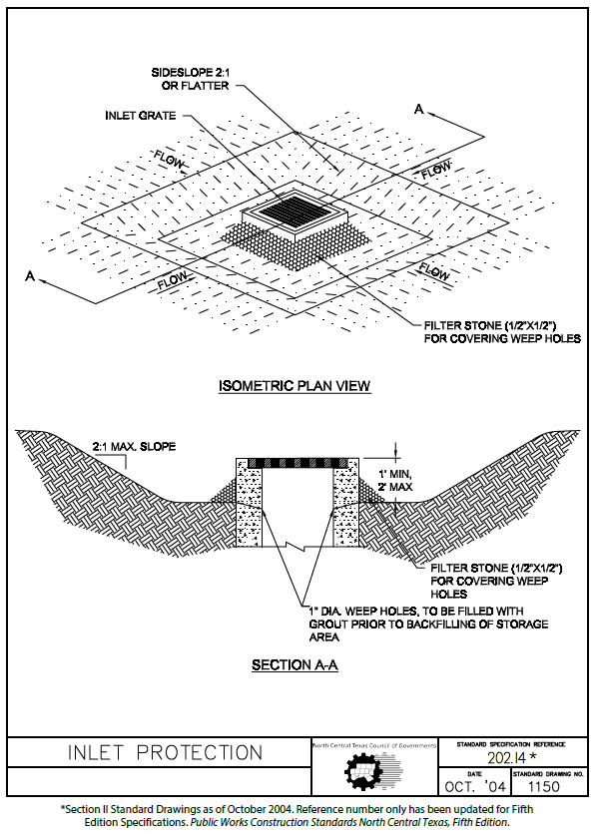
INLET PROTECTION-AREA
INLET PROTECTION-AREA
EXCAVATED IMPOUNDMENT

Slide 12
The following slides outline the edits made at the last meeting on
August 6, 2018

Slide 13
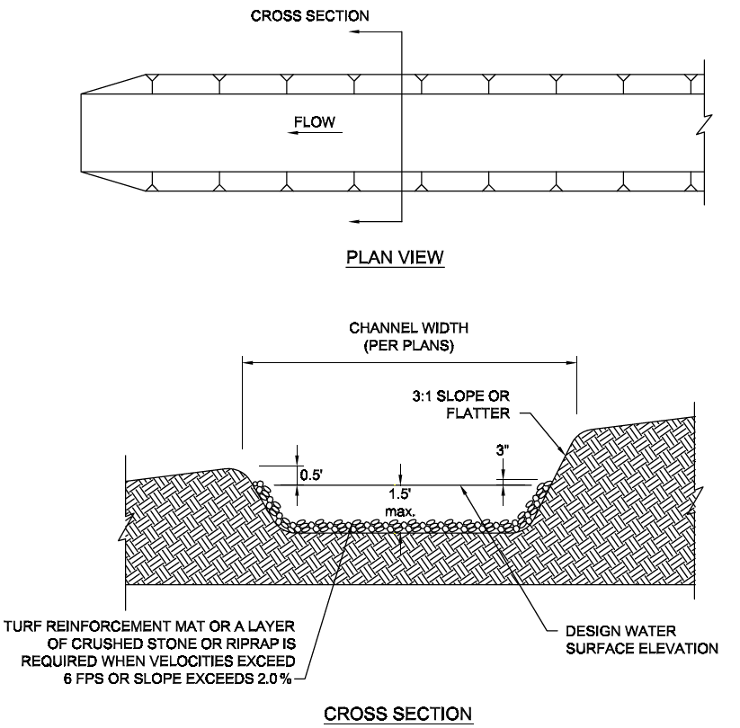
Longitudinal slope
Swale
max.
swale
Update Drawing Date
For channel material, see Note 6

Slide 14
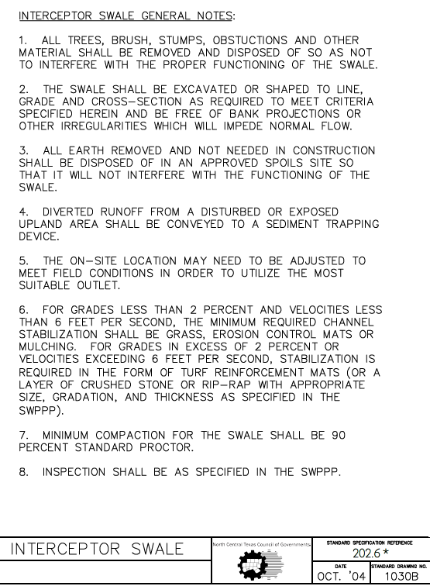
Provide edits/additions below:
9. For temporary stabilization rip-rap; width, depth, and surface water elevation should be designed by owner or owner’s representative.
10. Refer to Drawing 1230A and B for turf reinforcement mat.
11. See integrated Stormwater Management Manual for more information on interceptor swale.
Replace “grades” with “longitudinal slopes”
swale
STABILIZED RIP-RAP
PLANS
SEE NOTES 9 AND 10.
95%
Update Drawing Date

Slide 15
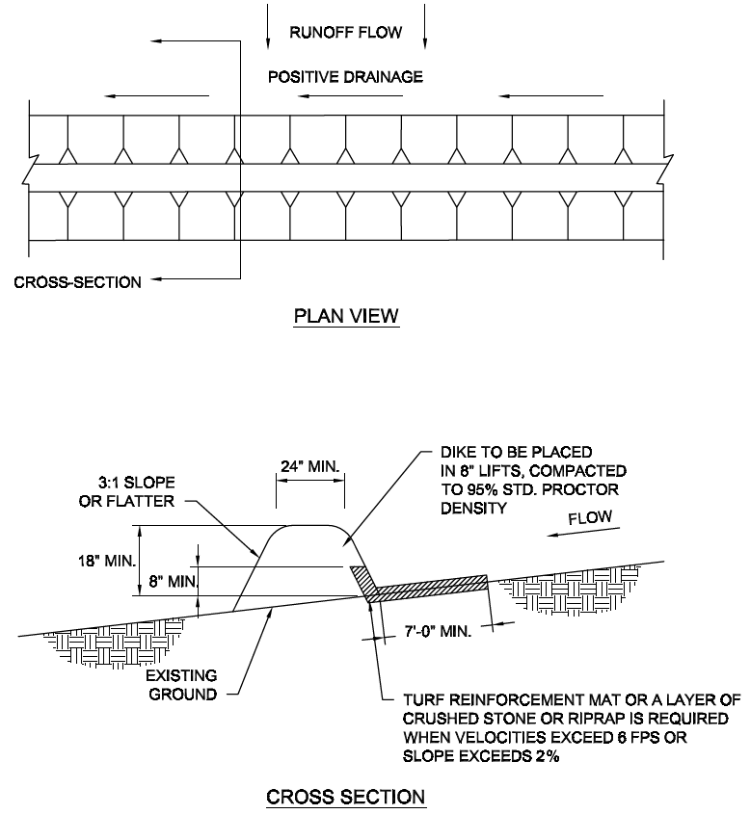
Plan view should include an “outlet flow” arrow.
See note 5
Update Drawing Date

Slide 16
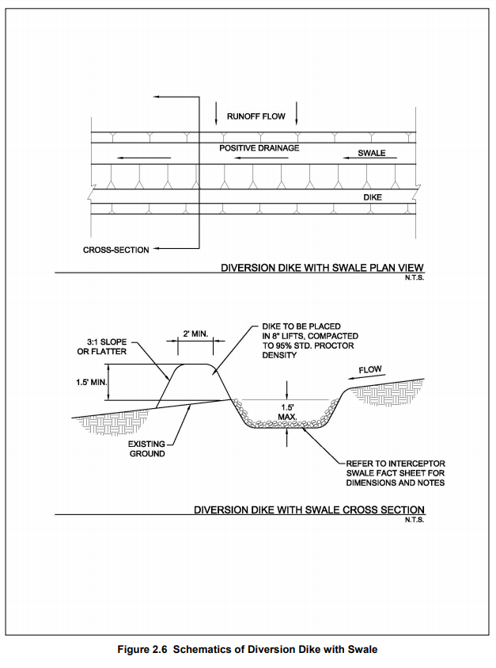
Arrows are upside down
STANDARD DRAWINGS 1030A AND 1030B.
Standard Specification Reference 202.7*
Date | Standard Drawing No. 1040B

Slide 17
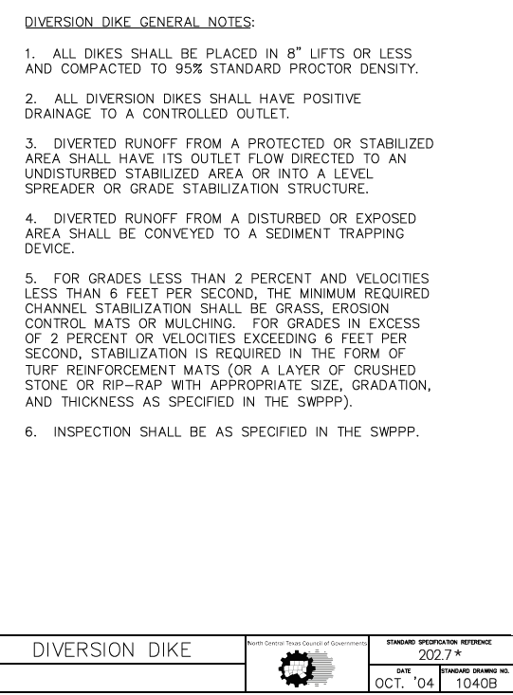
Provide edits/additions below:
7. See integrated Stormwater Management Manual for more information on Diversion Dikes.
8. For temporary stabilization rip-rap; width, depth, and surface water elevation should be designed by owner or owner’s representative.
9. Refer to Drawing 1230A and B for turf reinforcement mat.
“Refer to Item 202.7 in the Standard Specifications.”
Replace “grades” with “longitudinal slopes”
swale
STABILIZED RIP-RAP
SEE NOTES 8 AND 9.
PLANS
Update Drawing Date
1040C

Slide 18
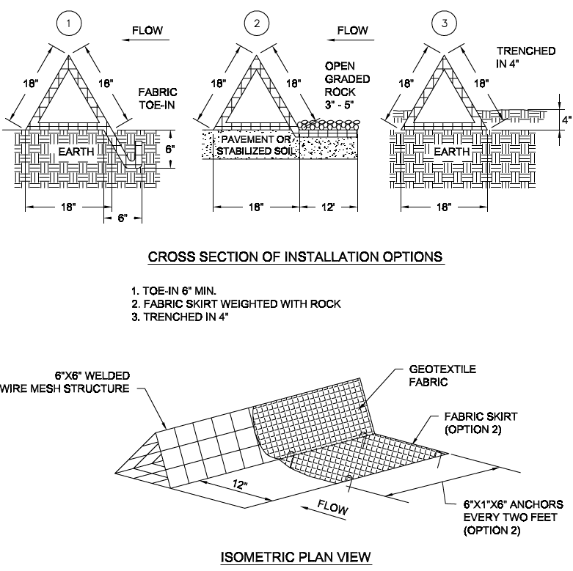
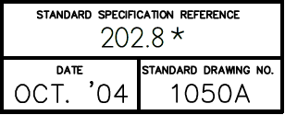
Replace 1050A with iSWM 3.32

Slide 19
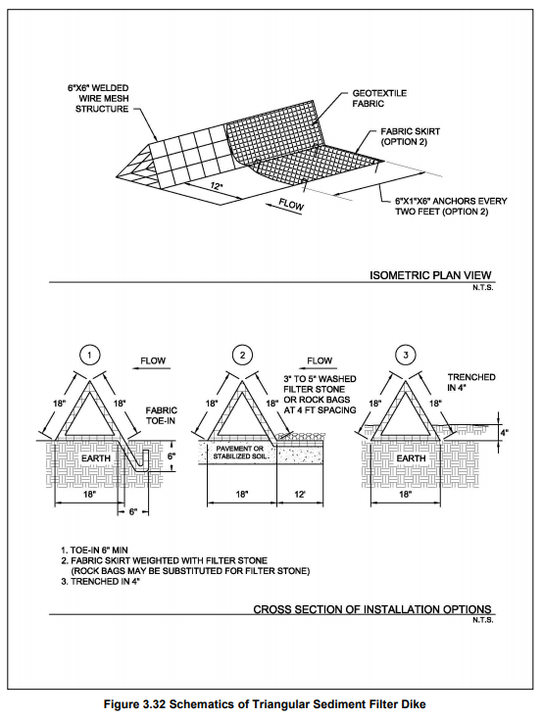
6” x 6” OR 4” x 4” WELDED WIRE MESH STRUCTURE
deep
Standard Specification Reference 202.8 *
Date | Standard Drawing No. 1050A

Slide 20
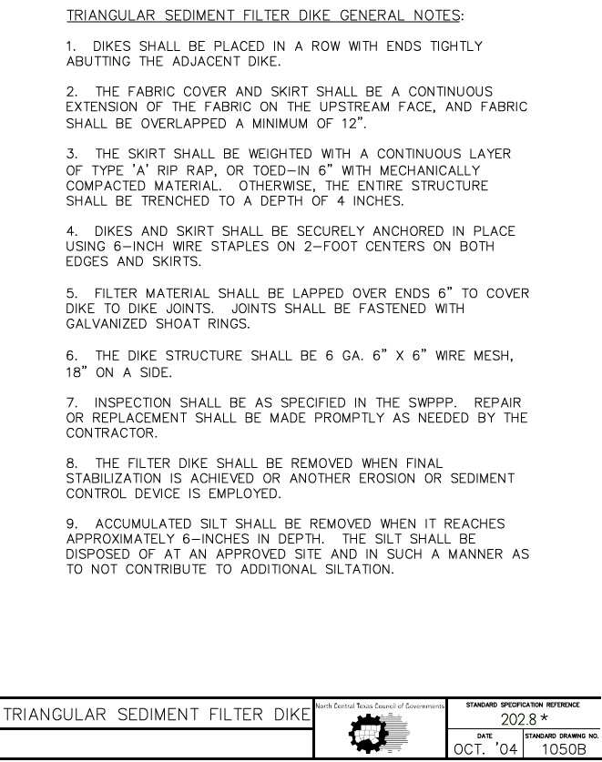
Provide edits/additions below:
6” x 6” or 4” x 4” WELDED WIRE MESH
Update Drawing Date

Slide 21
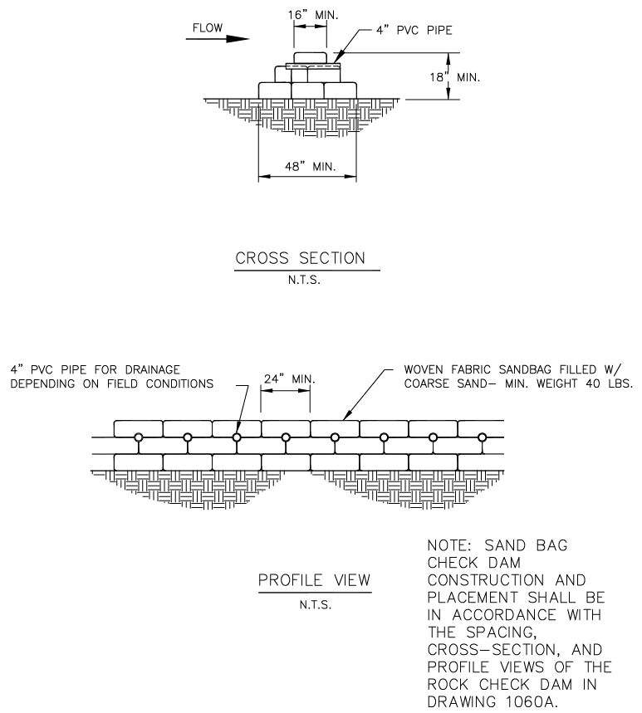
Replace 1080A with iSWM 2.2
REMOVE FROM PWCS

Slide 22
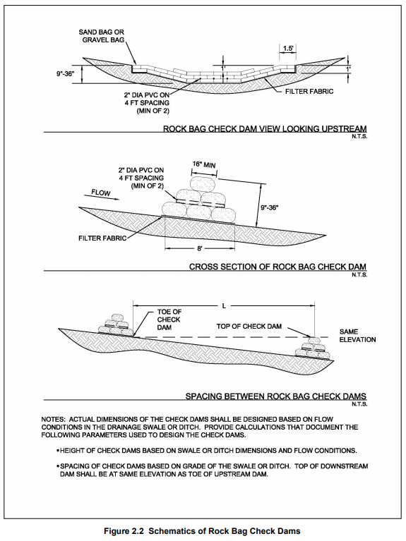
WILL NOT INCLUDE IN PWCS
Standard Specification Reference 202.10 *
Date | Standard Drawing No. 1080A

Slide 23
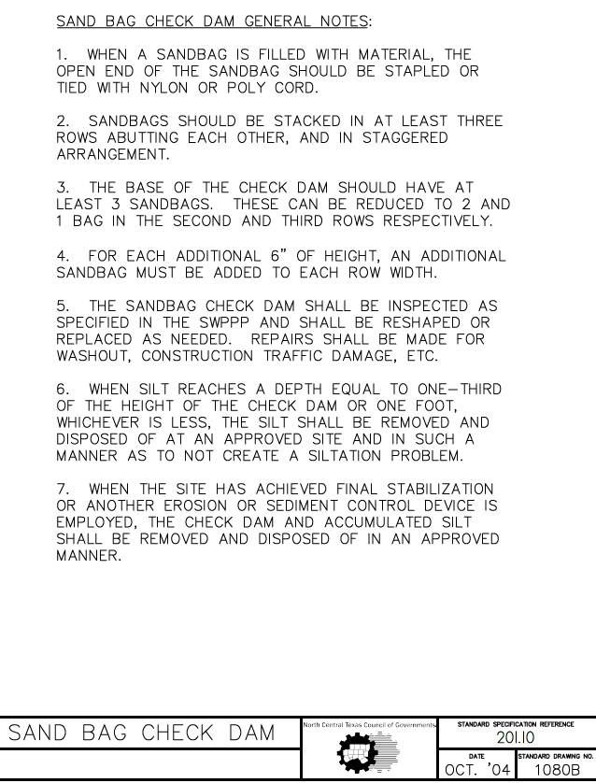
Provide edits/additions below:
8. See iSWM Manual for more information on Sand Bag Check Dam
REMOVE FROM PWCS
202.10

Slide 24
New Subcommittee Volunteer
Mathew L. Busby, PE, Lockwood, Andrews, & Newman, Inc. - Background in general civil engineering, 2008 SMU graduate - Served as a full-time construction manager and inspector for a year - Substantial experience in subsurface utility engineering (SUE), utility coordination, and utility relocations. - Focus is municipal work now, including street rehabilitations and replacements, culvert rehabilitations and replacements, bridge rehabilitations, erosion control, drainage design, roadway design, and water and wastewater facilities, rehabilitations, and replacements.

Slide 25
Next Steps
Determine action items for subcommittee members and NCTCOG staff

Slide 26
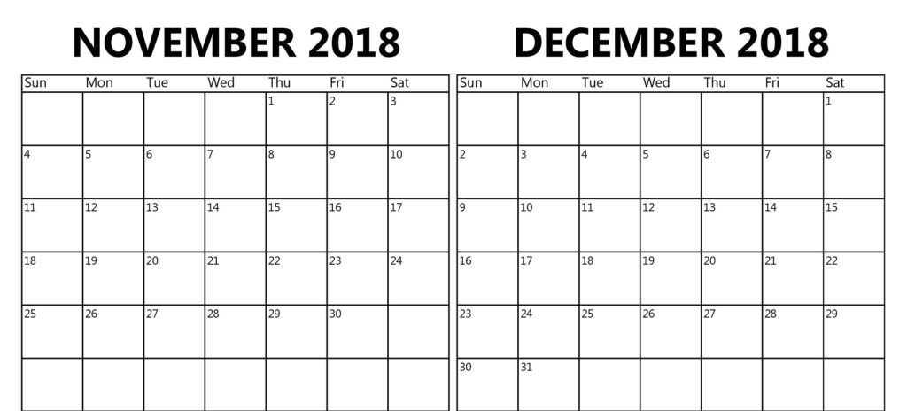
Next Meeting
Next Meeting scheduled for Monday October 22, 2018 at 10 a.m., Six Flags Conference Room
Future Meeting Dates
November 12, 2018
November 19, 2018
November 26, 2018
December 3, 2018
December 17, 2018
Thanksgiving
PWC

