Slide 1
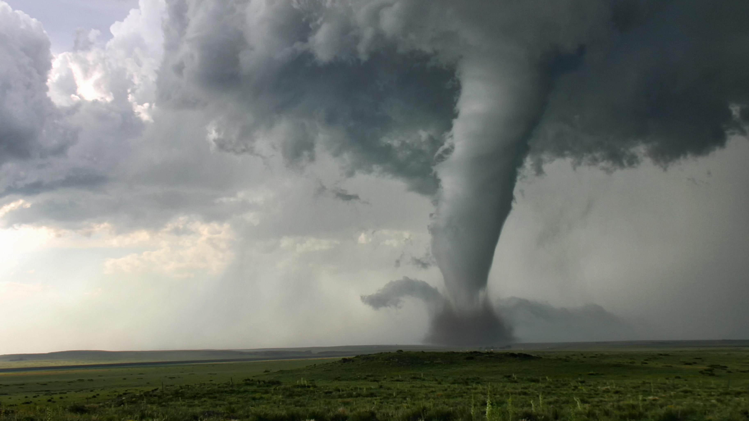
Texas Emerging Emergency Managers (TEEM)

Slide 2

Mission Statement
Texas Emerging Emergency Managers (TEEM) serves to provide a forum in the North Texas region for evolving professionals in emergency management. TEEM strives to provide a conducive environment that promotes professional development, knowledge sharing, and networking opportunities.

Slide 3

Structure
Leadership Positions (Elected Annually):
  President: Oversees group operations and event scheduling/coordination.
  Secretary: Takes notes for all meetings to provide to the group, collect records as needed.
  Outreach Coordinator: Focuses on bringing new members to the group.
Conduct monthly meetings – currently via Teams – provide training and professional development opportunities, regional updates from members, provide a field for open discussion on Emergency Management related topics, and host guest speakers from our field.

Slide 4

Who is this group for?
The primary audience this group seeks to connect is Emergency Managers (of any age) in the early stages of their careers.
  This is currently defined as 5 years or less of fulltime experience in the field.
This includes any Emergency Management related disciplines and jurisdictions within Texas.
The group currently consists of Emergency Management professionals from City, County, State, and Special District jurisdictions.

Slide 5

Thank You!
Formation Team
Anna Piasecki – Denton County
Brian Davis – Ellis County
Marina Garcia – City of Arlington
Damara Winfrey – City of Grand Prairie
Alexis Snyder – City of Richardson
Zach Ayer – TDEM
Joshua Moses – TDEM

Slide 6
Chance Huxtable
Emergency Management Specialist
DART Police Department
Phone: 214-749-5911
Email: Chuxtable@dart.org

