Slide 1
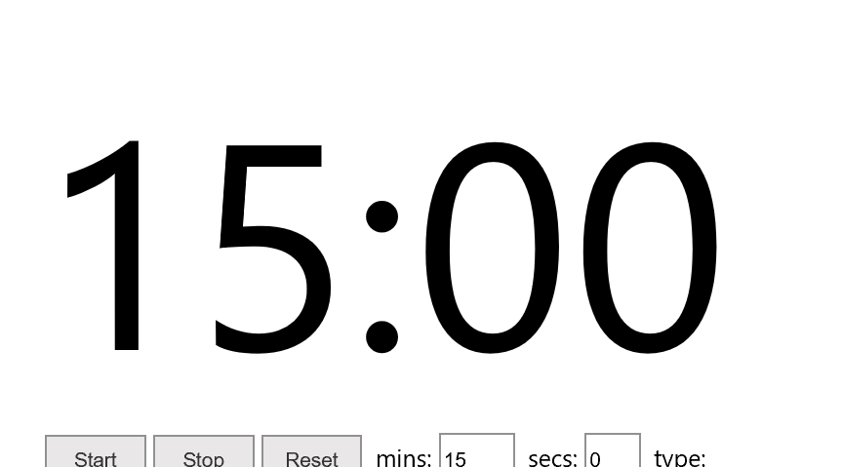
Regional Emergency Preparedness Advisory Committee (REPAC)
March 12, 2021

Slide 2
Meeting Reminders
To minimize disruptions, the following meeting guidelines will apply:
Please mute your microphone at all times unless speaking (e.g., make a motion, ask a question, etc.)
Please hold all question until after the presentation of each item. Please use the “raise your hand” feature to ask a question or make a comment.
The chat feature should be used for the sole purpose of requesting technical assistance. No business communications should be conducted using the chat function to ensure that meeting notes are captured accurately.
Motions to approve are allowed verbally. Please state your name and motion when speaking.
This meeting is being recorded.

Slide 3
Welcome
Opening Remarks
Roll Call
Approval of the last meeting’s notes

Slide 4
Discussion Items

Slide 5
FY20 Grant Updates

Slide 6
Cybersecurity Working Group

Slide 7
Cybersecurity Working Group
Why we need more assistance from Information Technology Departments
To ensure this working group is effective in not only submitting quality projects, but also identifying cybersecurity gaps across the region
To fulfill DHS Cyber Security requirement

Slide 8
HSGD Program Changes
National Priorities:
Enhancing Cyber Security – 7.5%
Enhancing the protection of soft targets/crowded places – 5%
Enhancing information and intelligence sharing and cooperation with federal agencies, including DHS – 5%
Addressing emerging threats – 5%
*Combating domestic violence extremism – 7.5%

Slide 9
Combating Domestic Violent Extremism
Project Examples:
Open-source analysis of misinformation campaigns, targeted violence and threats to life, including tips/leads, and online/social media-based threats
Sharing and leveraging intelligence and information, including open-source analysis
Execution and management of threat assessment programs to identify, evaluate, and analyze indicators and behaviors indicative of domestic violent extremists
Training and awareness programs (e.g., through social media, suspicious activity reporting [SAR] indicators and behaviors) to help prevent radicalization
Training and awareness programs (e.g., through social media, SAR indicators and behaviors) to educate the public on misinformation campaigns and resources to help them identify and report potential instances of domestic violent extremism

Slide 10
FY21 SHSP Timeline and Path Forward

Slide 11
FY 2021 SHSP Project Scoring Results
Rank | Project | Cost
Carveout | Regional Planning | $393,880.36
Carveout | Citizen Corps Program | $30,000.00
1 | Explosive Ordinance and Disposal | $410,000.00
2 | Training and Exercise | $79,275.00
3 | Cybersecurity | $126,000.00
4 | Special Weapons and Tactics | $224,377.50
5 | Public Works Emergency Response Team | $94,956.90
6 | Emergency Management | $384,300.00
7 | Urban Search and Rescue | $150,248.43
8 | Interoperability | $43,365.00
9 | Fusion | $137,583.00
10 | Public Education | $44,100.00
11 | Hazardous Materials | $130,000.00
 | Total | $2,248,086.19

Slide 12
FY21 SHSP Timeline
Task | SHSP
OOG Batches Applications to COG for Prioritization | 03/15/2020
COG Completes Prioritization in eGrants | 03/31/2020
HSGD Reviews and Submits Federal Application | 05/14/2020
HSGD Completes Initial Grant Review | 05/14/2020
PRR Issues Resolved | 06/01/2020
CCH Compliance Confirmed/OOG Review Complete | 08/01/2020
Awards Ready for Release | TBD

Slide 13
After Action Review Committee Meeting Sign-up
Meeting Date:
Tuesday, May 11, 2021
1:30 – 3:30 PM
Please sign up via the link posted in the chat.

Slide 14
THIRA/RIP/SPR Update

Slide 15
Regional Complex Coordinated Terrorist Attack Grant Update

Slide 16
COVID-19 Vaccination Efforts

Slide 17
Upcoming Dates
April 8, 2021 – Emergency Management Working Group
April 15, 2021 – Cyber Security Working Group
May 13-14, 2021 – Texas Volunteer Management Conference (Virtual)
May 20, 2021– EPPC Meeting
August 30 – September 2, 2021 – National Homeland Security Conference (Las Vegas)

Slide 18
NCTCOG Updates

Slide 19
Announcements
Committee/ Public Comments
Adjournment
Next Meeting:
June 3, 2021
9:30 – 11:30 AM

