Slide 1

TEXPRESS
LANES:
A REGIONAL OVERVIEW

Slide 2
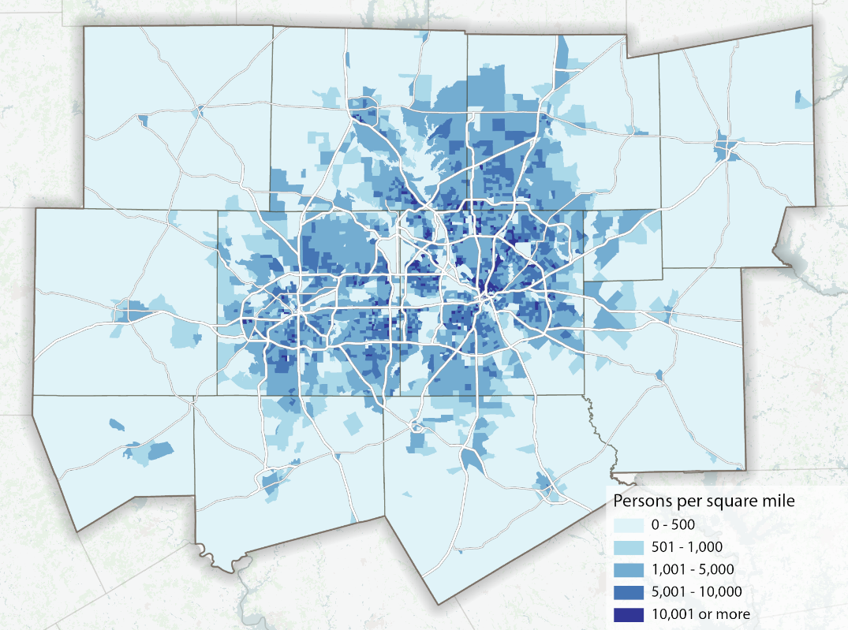
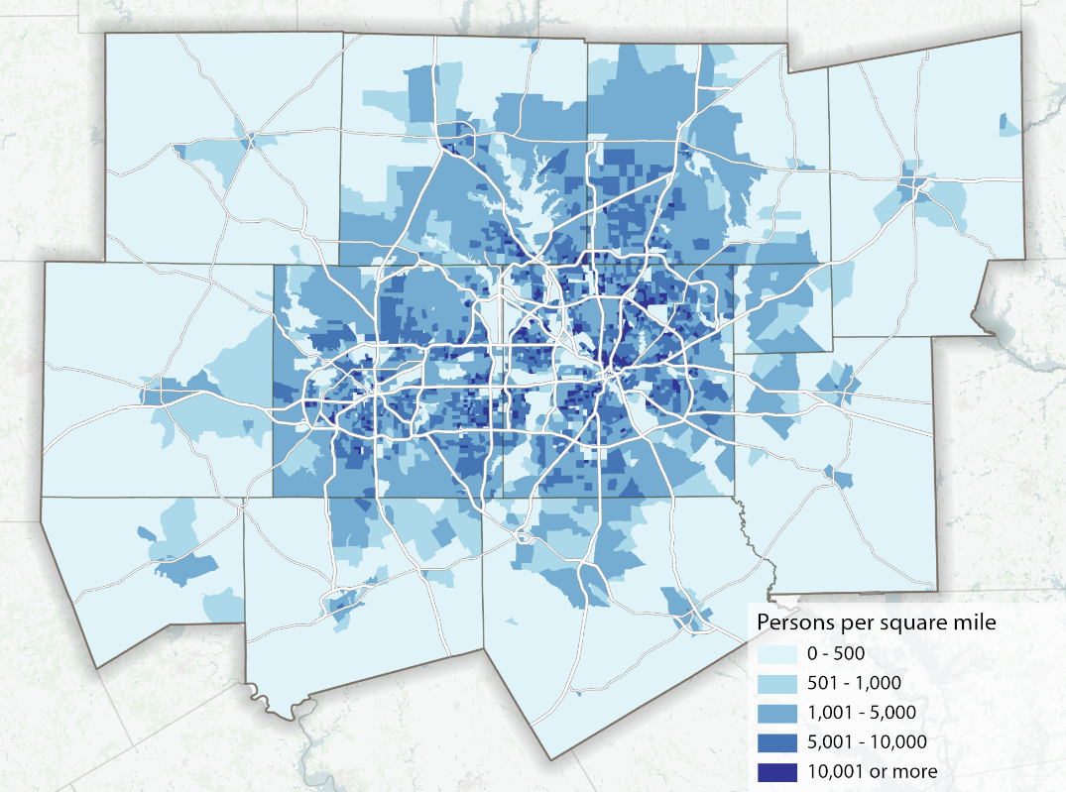
REGIONAL GROWTH
2023
2045
Source: NCTCOG 2045 Demographic Forecast
The Dallas-Fort Worth area has more than 8 million people living in the 16-county region and continues to add approximately 1 million new residents per decade.

Slide 3
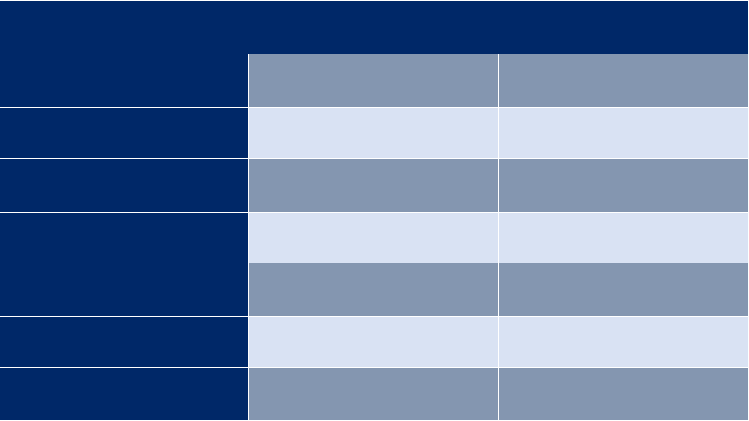
TEXPRESSLANES
ESTIMATED REGIONAL GROWTH
2023
2045
POPULATION
8,153,519
11,411,548
EMPLOYMENT
5,724,039
8,111,082
VEHICLE MILES OF TRAVEL
226,506,567
325,516,238
HOURLY CAPACITY
(MILES)
44,583,406
54,157,935
VEHICLE HOURS
SPENT IN DELAY
1,812,065
4,101,174
INCREASE IN TRAVEL TIME DUE TO CONGESTION
37.28%
59.42%%
ANNUAL COST OF CONGESTION (BILLIONS)
$13.3
$30.1
Mobility 2045: The Metropolitan Transportation Plan for North Central Texas – 2022 Update

Slide 4
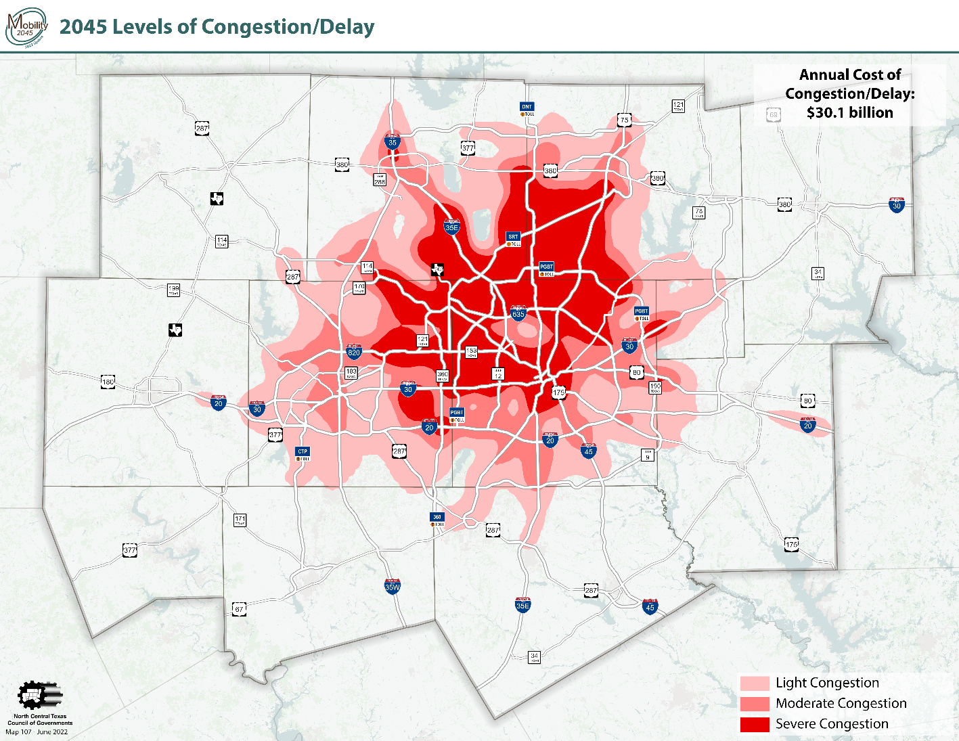
CONGESTION LEVELS
Source: NCTCOG 2045 Demographic Forecast
Current transportation funding is not keeping pace with the need to maintain and provide capacity improvements for the growing population, increasing congestion throughout the region.

Slide 5
TEXPRESSLANES
FUNDING CHALLENGES
State fuel taxes have not increased since 1991.
Federal fuel taxes have not increased since 1993.
The gas tax has lost much of its purchasing power and cannot sufficiently fund our roadways.
Increased construction costs
More
fuel-efficient vehicles

Slide 6
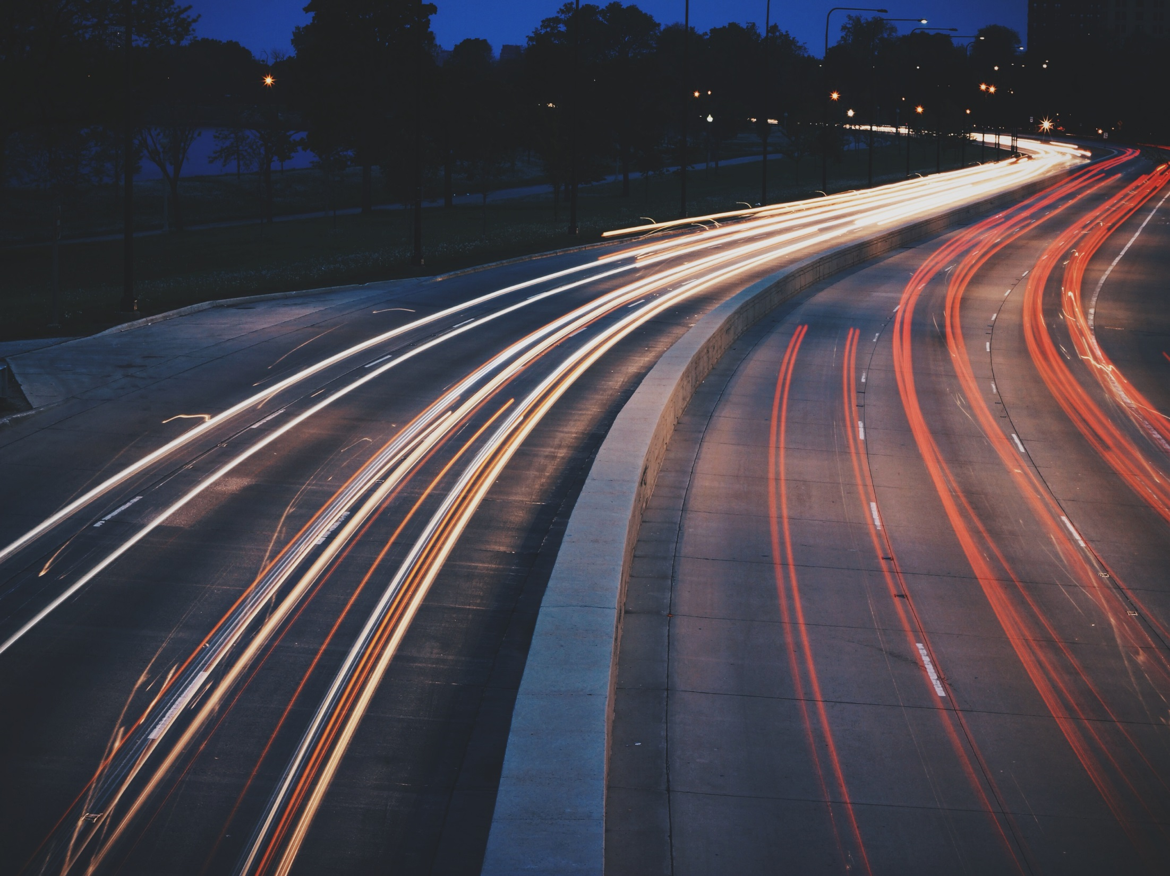
EXPLORING ALTERNATIVES
TEXpress Lanes expedite projects
Create extra capacity
Provide reliable travel times
Provide an option to drive on rebuilt, non-tolled lanes
Pay for their maintenance over time

Slide 7
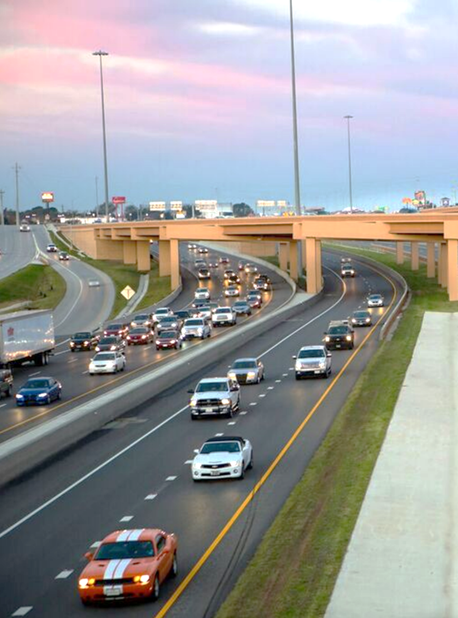
TEXPRESSLANES
WHAT ARE TEXPRESS LANES?
TEXpress Lanes are unique toll lanes that are built within an existing highway. They add additional capacity to the highway to accommodate more traffic to relieve congestion.

Slide 8
TEXPRESSLANES
HOW DO TEXPRESS LANES WORK?
Pricing on TEXpress Lanes is adjusted based upon the average speed and number of drivers on the TEXpress Lanes. Drivers are notified of the price they will pay on the toll pricing signs prior to entering any segment of the TEXpress Lanes.

Slide 9
NTE TEXPRESS USAGE FACTS
1 in 5
$5-15
3 million
TOLL TAGS
TRIPS ON TEXPRESS
BILL/MONTH
About 3 million toll tags seen on Managed Lanes in the past year out of 5.3 million active tags in North Texas.
The average TollTag user chooses the TEXpress Lanes for 1 in every 5 trips.
Most drivers who choose the TEXpress Lanes have a bill between $5-$15 per month.

Slide 10
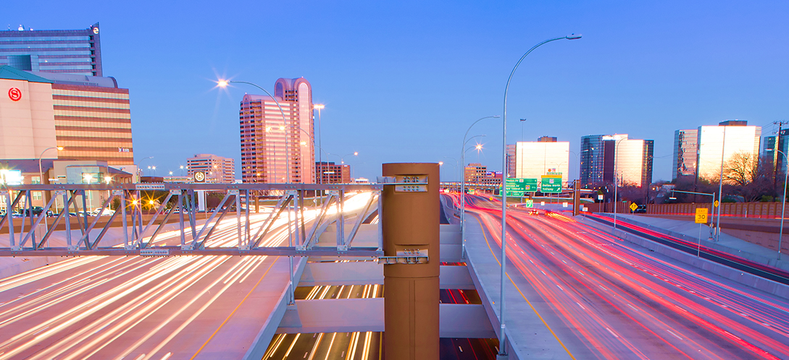

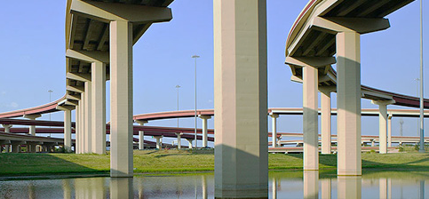
TEXPRESSLANES
TEXPRESS LANES
TEXpress Lanes add capacity alongside non-tolled lanes and use a pricing model with rates that fluctuate depending on traffic.
COMPARED TO
TOLL ROADS
NTTA toll roads charge standard, non-fluctuating toll fees.

Slide 11
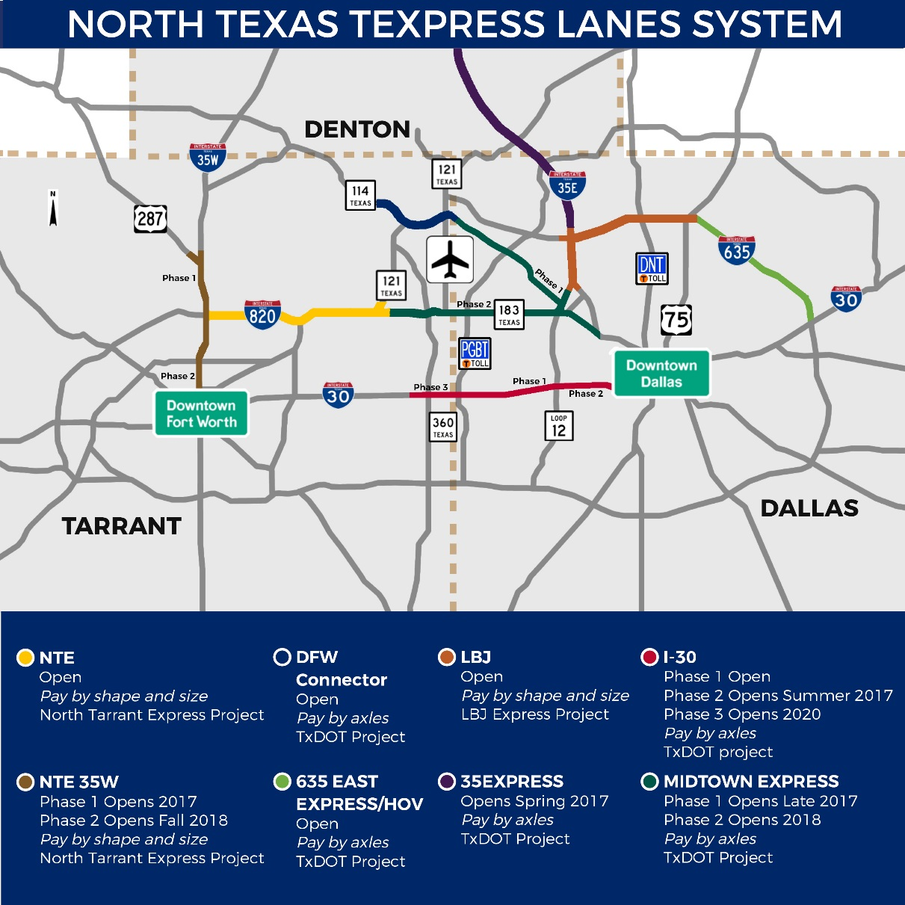
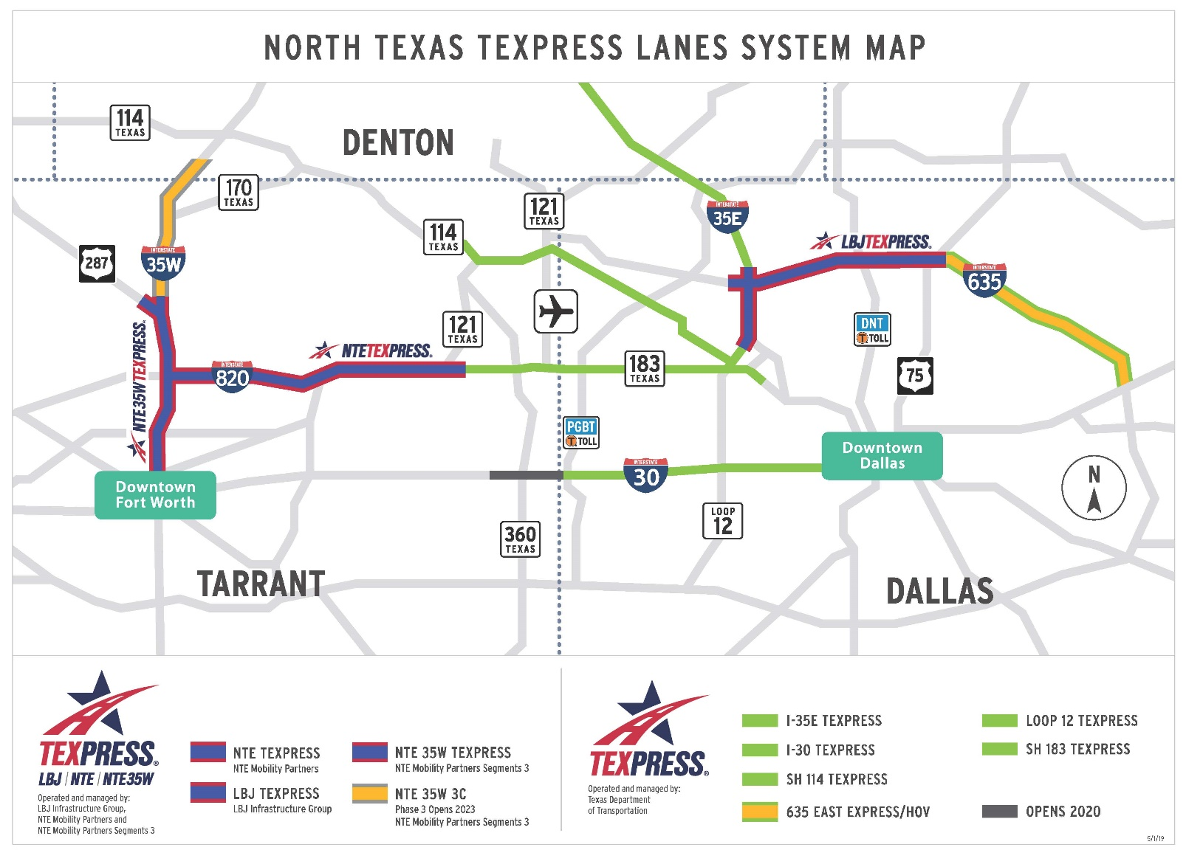
SYSTEM MAP
TEXPRESSLANES
TEXpress Lanes can be found throughout the region.

Slide 12
TEXPRESSLANES
OPERATING PROJECTS
 | MILES | INVESTMENT | PUBLIC FUNDING | OPEN SINCE
NTE TEXPRESS | 13.3 | $2.1 BILLION | 28% | OCTOBER 2014
LBJ TEXPRESS | 13.3 | $2.6 BILLION | 18% | SEPTEMBER 2015
NTE 35W TEXPRESS | 10.2 | $1.4 BILLION | 5% | JULY 2018

Slide 13
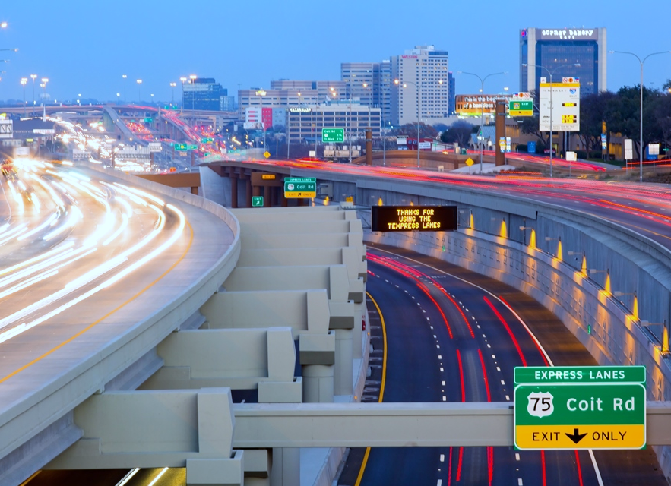
TEXPRESSLANES
CHOOSING
TEXPRESS
Drivers can always choose to drive the existing non-tolled lanes or choose TEXpress Lanes.

Slide 14




TEXPRESSLANES
CHOOSING TEXPRESS
TEXpress Lanes are designed for drivers who want a reliable and time-saving trip to reach many destinations.
WORK
HOME
SPORTS
AIRPORT
Drivers can make the best choice for them based on their own needs each time they drive on a roadway with TEXpress Lanes.

Slide 15
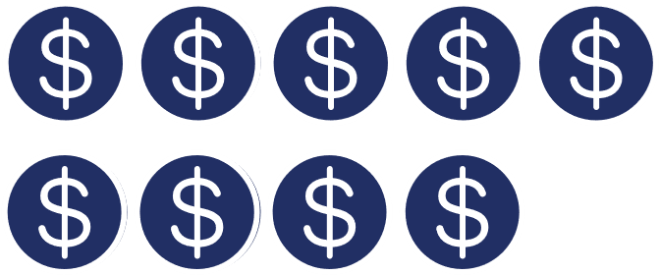

TEXpress
Lanes
25+ million different vehicles have used the LBJ, NTE & NTE 35W TEXpress Lanes to date
are for everyone
Over 90% of managed lane trips are under $10
Each managed lane trip is
8 miles on average
85% of drivers who use managed lanes take less than 2 trips each week, only when they need it
73% view TEXpress Lanes favorably
Over 8 million
people live in
Dallas-Fort Worth
Source: LBJ TEXpress and NTE TEXpress Lanes

Slide 16




TEXPRESSLANES
BENEFITS
$
$
$
$
REDUCES CONGESTION
ECONOMIC DEVELOPMENT
AIR QUALITY

Slide 17
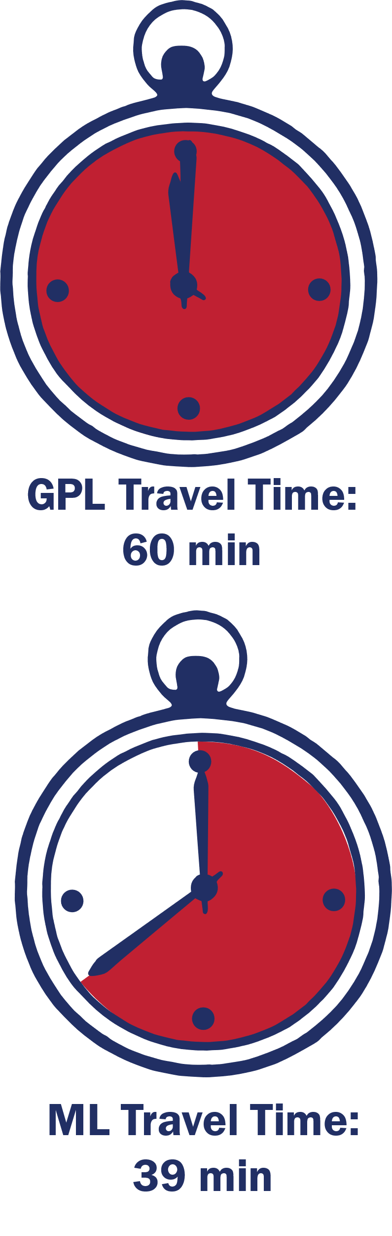
TEXPRESSLANES
REDUCES CONGESTION
TEXpress or Tolled Managed Lanes are designed to keep traffic moving above 50 mph. They allow for expanded capacity without reducing efficiency.
With traffic demand built up in the past 10 years, traffic conditions and reliability in the General Purpose Lanes (GPL) have inevitably deteriorated
35% Peak Hour Travel Time Saved on Managed Lanes (ML)
Source: LBJ TEXpress and NTE TEXpress Lanes

Slide 18
TEXPRESSLANES
ECONOMIC DEVELOPMENT
Improved transportation corridors bring:
Economic development
Increased property values
Additional tax revenues

Slide 19


TEXPRESSLANES
AIR QUALITY
Less stop-and-go traffic conditions help reduce emissions, helping improve air quality.

Slide 20
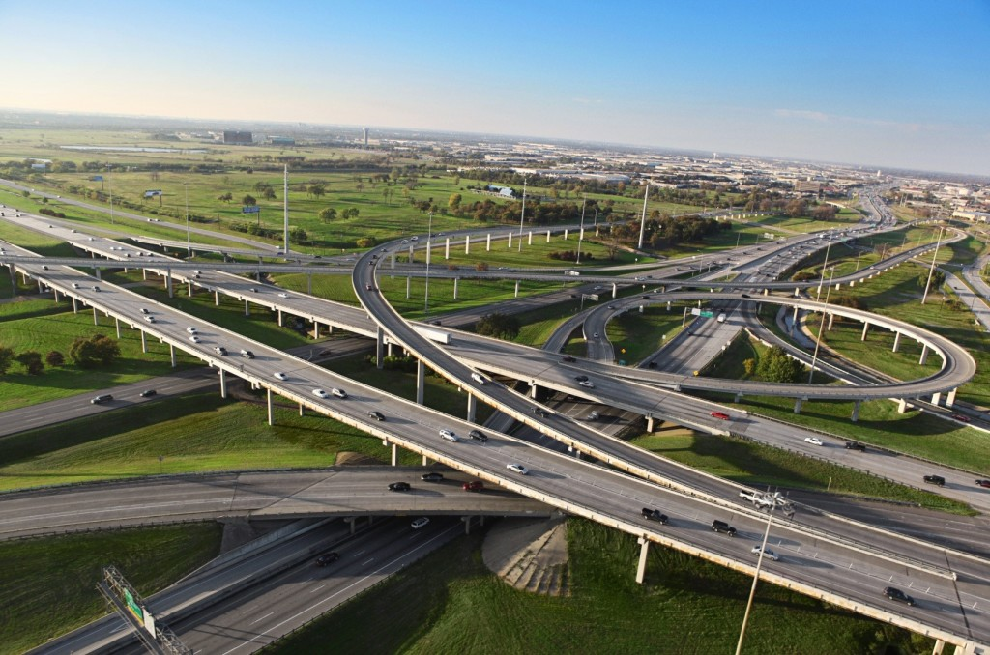

It’s all about drivers who want a more reliable commute.
TEXpress Lanes are a needed choice for North Texas residents.
TEXPRESSLANES.COM

