Slide 1
2023 UNIFIED TRANSPORTATION PROGRAM (UTP) AND REGIONAL 10-YEAR PLAN UPDATE
Regional Transportation Council
August 18, 2022

Slide 2
BACKGROUND
Texas House Bill (HB) 20 requires that Metropolitan Planning Organizations (MPO) develop 10-Year Plans using performance-based planning and project selection methods.
Includes projects funded with Category 2 (MPO-selected), Category 4 (TxDOT District-selected), and Category 12 (Texas Transportation Commission [TTC]-selected)
This plan is updated annually in conjunction with the development of TxDOT’s UTP.

Slide 3
ACTIVITIES SINCE LAST UPDATE AND PROPOSED PATH FORWARD ON CATEGORY 2 REQUESTS
Received feedback in early June from TxDOT Headquarters regarding the region’s funding requests
Not all of the region’s requested Category 2 funds were picked up
Discrepancies between the carryover balances that TxDOT Headquarters and NCTCOG/TxDOT Districts are showing led to more funding requested than is available.
Several Category 2 projects that were part of the SL 9/US 287 funding exchange the RTC approved in 2021 must still be included in the UTP:
TxDOT Headquarters prefers not to include all projects at this time
Include IH 820 at Trinity Railway Express (TRE) project in the 2023 UTP as it lets May 2023 ($18 million)
Remaining projects from the SL 9/US 287 trade to be added to the 2024 UTP
To stay under the available funding, the Category 2 request for US 81/US 287 from South of North Tarrant Parkway to Avondale Haslet Road must be reduced temporarily by $18 million

Slide 4
PRINCIPLES FOR THE DEVELOPMENT OF THE REGIONAL 10-YEAR PLAN
Project should be included in Metropolitan Transportation Plan
Focus on “system” versus new, stand-alone projects
Fully fund existing projects before funding new projects
Ensure equity of county allocations
Maintain toll lanes/toll managed lanes on selected corridors
Re-fund previously unfunded projects, when possible
Ensure all RTC projects are approved in 2023 UTP (including “placeholders”)
Projects must be scored and should have a score sufficient to qualify for funding

Slide 5
REGIONAL FUNDING ALLOCATIONS FOR 2017-2023 UTPs
Funding Category | 2017 Allocation | 2018 Allocation | 2019 Allocation | 2020 Allocation | 2021 Allocation | 2022 Allocation | 2023 Proposed Allocation
Category 2 | $3.784 | $3.607 | $3.832 | $3.516 | $2.913 | $2.931 | $3.205
Category 4 | $0.830 | $1.553 | $1.637 | $1.537 | $1.340 | $1.348 | $1.593
Category 12 | $0.812 | $2.130 | $1.395 | $3.041 | $3.089 | $2.601 | $3.132
Total Allocation | $5.426 | $7.290 | $6.864 | $8.094 | $7.342 | $6.880 | $7.930

Slide 6
PROPOSED SOUTHEAST CONNECTOR FUNDING EXCHANGES
The Southeast Connector project came in $800 million over the estimate
The project was split into four pieces, with only the first one being fully funded
Seeking funding for only one additional segment, which costs $468 million
A partnership with the TTC is proposed to move Category 2 funds from existing projects in out-years to the Southeast Connector, with Category 12 funds replacing those Category 2 funds.
If TxDOT and the TTC agree to this proposal, the RTC will request that an Interlocal Agreement be developed so the Category 12 funding cannot be rescinded.

Slide 7
PROPOSED SOUTHEAST CONNECTOR FUNDING EXCHANGES (CONTINUED)
Surface Transportation Block Grant (STBG) funds are not being obligated as quickly as needed, so a Category 2/STBG funding exchange is proposed.
$97.9 million of Category 2 funds currently on the Southeast Connector project are proposed to be exchanged with STBG funds on existing projects since this section can go to construction in FY2022.
All projects/actions proposed in the exchanges are included in the draft 2023 UTP.
Refer to comment section in Planned Project list for specific projects.

Slide 8
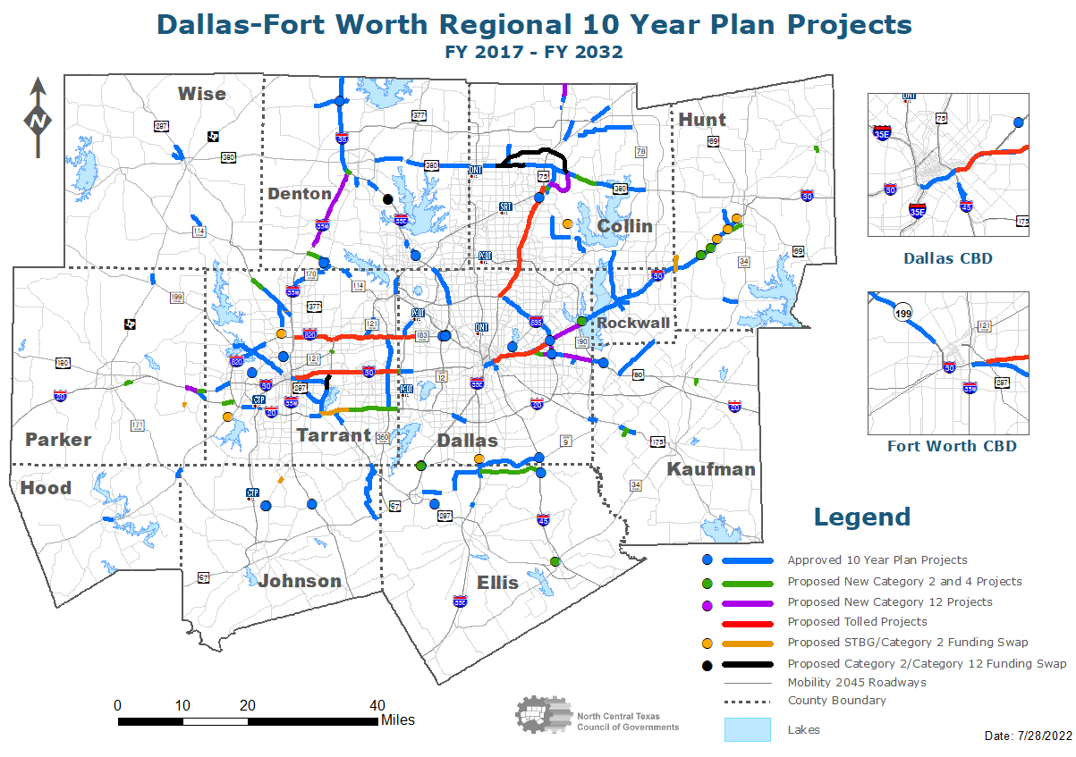

Slide 9
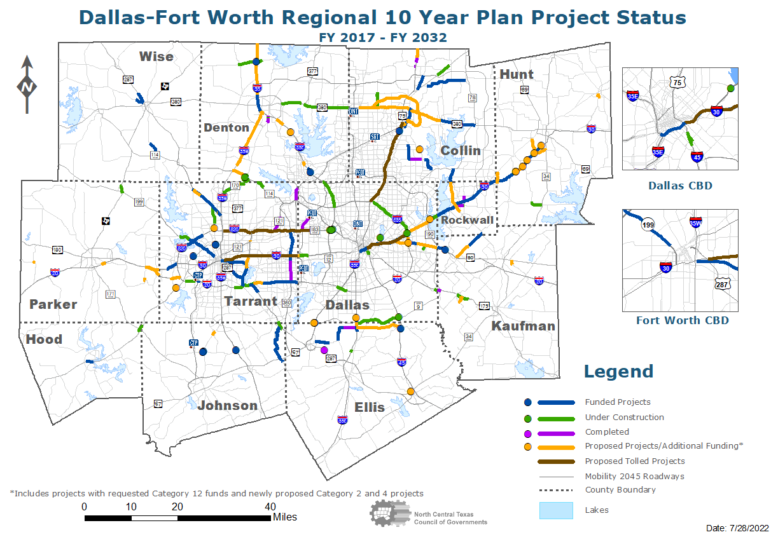

Slide 10
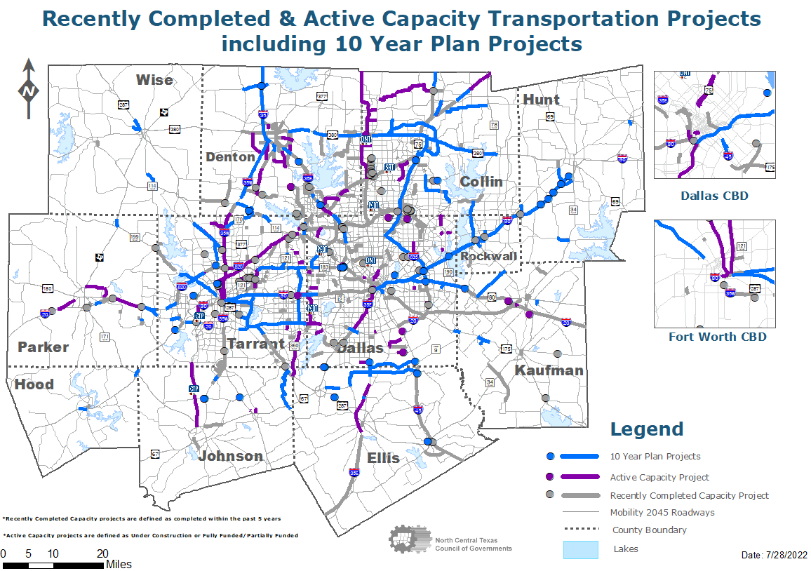

Slide 11
NEXT STEPS
Bring back any project changes (if needed) to the committees once the TTC approves the 2023 UTP
Continue to coordinate with TxDOT on resolving issues with the region’s Category 2 carryover balance
Finalize overall distribution between the Eastern and Western subregions as a result of the trades/lettings over time

Slide 12
TIMELINE
MEETING/TASK | DATE
Funding Targets Received | February 2022
Initial draft list due to TxDOT | March 1, 2022
Public Involvement | June 2022
STTC Information | June 24, 2022
RTC Information | July 14, 2022
STTC Action | July 22, 2022
RTC Action | August 18, 2022
TxDOT Public Involvement for 2023 UTP | July 8–August 8, 2022
Anticipated TTC Approval of 2023 UTP | August 30, 2022

Slide 13
REQUESTED ACTION
RTC approval of:
The 2022 Regional 10-Year Plan project listing
The proposed funding exchanges
Administratively amending the Transportation Improvement Program (TIP)/Statewide Transportation Improvement Program (STIP) and amending other planning/administrative documents to incorporate these changes

Slide 14
CONTACT/QUESTIONS?
Christie J. Gotti
Senior Program Manager
Ph: (817) 608-2338
cgotti@nctcog.org
Brian Dell
Principal Transportation Planner
Ph: (817) 704-5694
bdell@nctcog.org
Cody Derrick
Transportation Planner III
Ph: (817) 608-2391
cderrick@nctcog.org

