Slide 1
Flood Management Task Force
June 26, 2020

Slide 2
Welcome and Introductions
Thanks for attending!
Please introduce yourself in the chat box.
Please mute your line.
Unmute your line when you would like to speak during question and discussion time.
  We will also watch the chat and Q&A boxes for questions

Slide 3
Meeting Summary
The link to the meeting summary is available in the download box.
Please inform me of any corrections or additions.

Slide 4
FY20 Trinity River Common Vision Work Program Activities Discussion
NFIP/CDC Model Consolidation Team
The FMTF approved the Consolidation Team’s Memo in January. The USACE has submitted two scopes for work related to the model consolidation.
  Updating the newly georeferenced CDC model with approved but not yet constructed CDC project geometries from 2017 onward and future flows.
  Creating the CDC future flows for the FEMA detailed study on the East Fork Trinity and the Trinity mainstem to extend the consolidated model.
NCTCOG staff have submitted a request for $485,000 in funding to the USACE from their Planning Assistance to States (PAS) and Floodplain Management Services in hopes to offset the cost to communities. Thank you to the communities that provided letters of support. The USACE approved the applications for 100% federal funding. Updates will be provided as they become available.

Slide 5
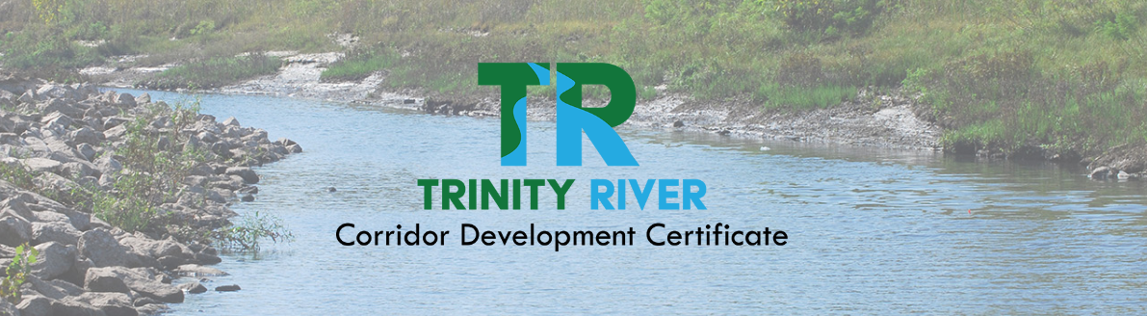
FY20 Trinity River Common Vision Work Program Activities Discussion
CDC Model Repository and Application Website: www.trinityrivercdc.com
Plan to go live with all functionality on October 1st.
Member communities will receive an email from Mia Brown asking for verification of individuals who need accounts on the website.
Later this summer, you will see materials from NCTCOG with instructions for submitting CDC applications on the website. Tutorials/webinars will follow.

Slide 6
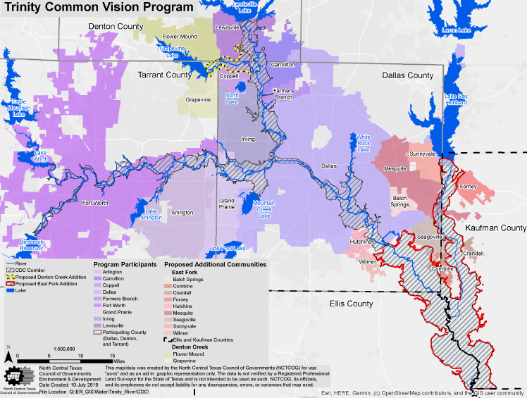
FY20 Trinity River Common Vision Work Program Activities Discussion
East Fork/Denton Creek Update
NCTCOG staff is sending letters to Grapevine and Flower Mound inviting them to join Trinity Common Vision.
The City of Mesquite is taking the East Fork resolution to a future council meeting and will discuss membership with Forney and Sunnyvale.

Slide 7
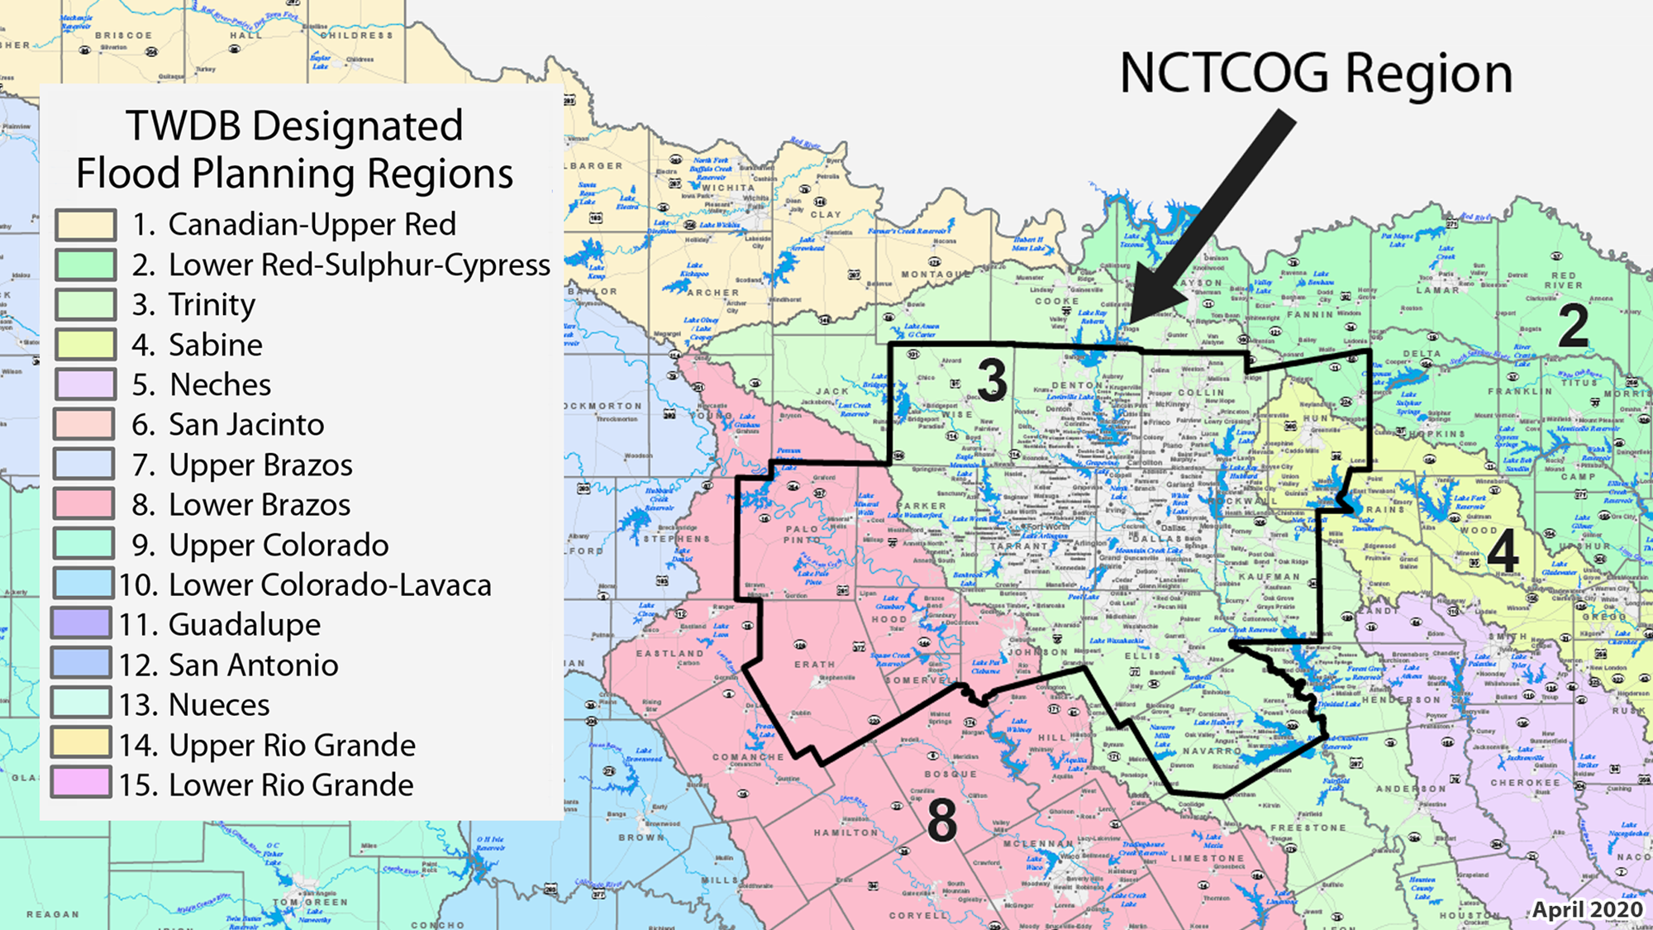
FY20 Trinity River Common Vision Work Program: Ongoing Support Activities
NCTCOG Participation in the TWDB Flood Planning Process
Nominations are due to TWDB on July 2nd for the following related to Regional Flood Planning Groups (RFPGs):
  Membership of one individual in each of the 12 interest categories for each RFPG
    Edith Marvin has submitted a nomination for membership in the Environmental Interests category for the Trinity River RFPG.
  RFPG Sponsor
    NCTCOG has nominated itself for sponsor of the Trinity River RFPG.

Slide 8



FY20 Trinity River Common Vision Work Program: Ongoing Support Activities
OneRain Regional Flood Software
Regional software requested by FMTF in 2016. Entities currently on the common contract are McKinney, Arlington, Frisco, and TRWD. Fort Worth and Grand Prairie feed their data into the platform.
Current contract for services is through North Texas SHARE and expires July 5, 2020.
NCTCOG staff met with OneRain’s Product Manager on 6/25 to discuss contract renewal with a model more focused on partnership. A contract extension is anticipated to be signed in early July. Details will follow as soon as we have them.

Slide 9
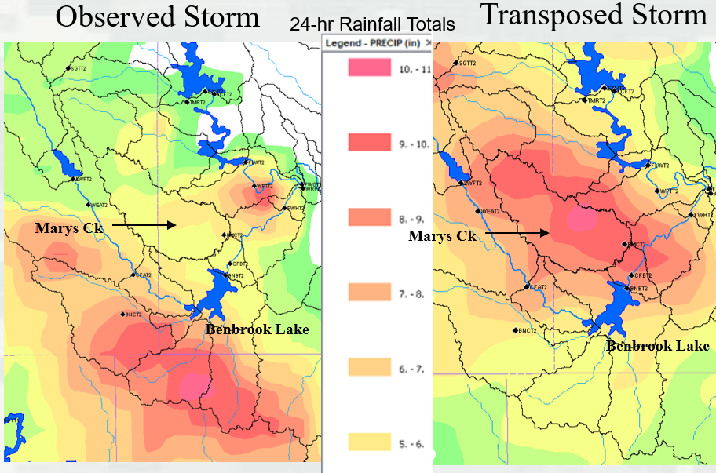
FY20 Trinity River Common Vision Work Program: Ongoing Support Activities
Application to USACE Silver Jackets for a Storm Shifting Study on the Upper Trinity River
  Shifting/moving of large storms in the region
  Utilizes existing engineering models and data to produce hypothetical scenarios
  Storm/scenario selection based on collaboration between USACE, NCTCOG, and the Communities.
  HEC-MetVue (Publicly Available)
  $100,000 12 months
  NCTCOG hopes to hear back on funding in July.
June 2000 storm transposed 15 miles North

Slide 10
FY21 Trinity River Common Vision Draft Work Program Discussion
A link to the Draft FY21 Work Program is available in the download box.
Additions to existing Ongoing Support Activities
  Maintenance of CDC Application and Tracking Website
Additional Technical Activities
  Participation in the Model Consolidation Committee
  Update the CDC Manual to the 5th Edition
  East Fork Trinity and Denton Creek Integration
No change in the annual cost shares; total program cost of $100,000
  East Fork Communities will not be invoiced this year since CDC products are not yet available.

Slide 11
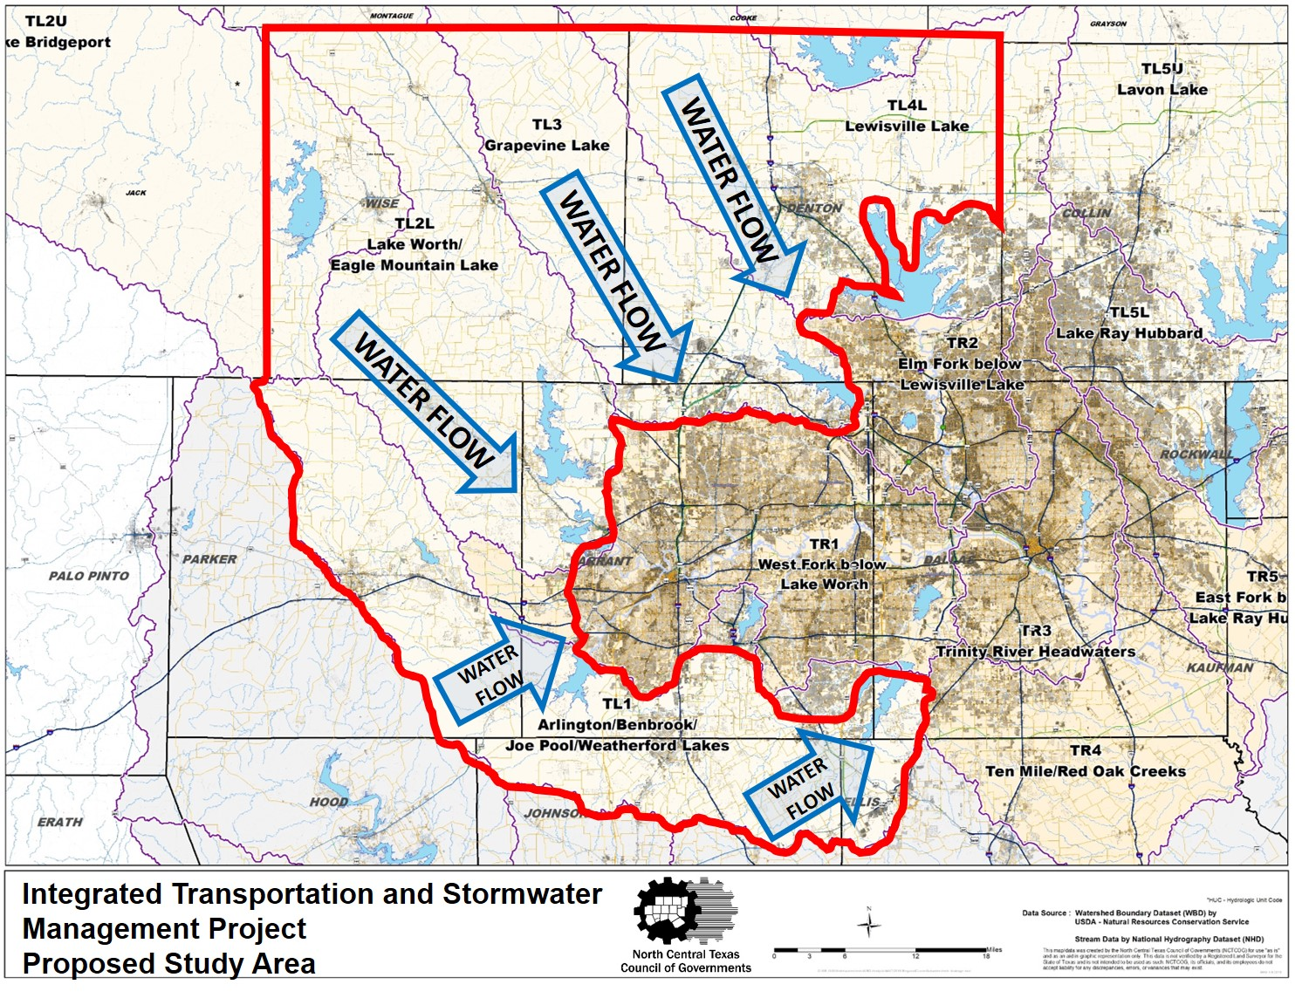
Other Program Related Efforts
Update on Efforts Toward Integrated Transportation & Stormwater Planning
A webinar was held on June 18th for staff and elected officials in the project area to discuss the project scope, benefits to communities, and an update on progress toward obtaining funding.
The recording can be viewed at: https://www.youtube.com/watch?v=eXGJTHLiRbg

Slide 12
Other Program Related Efforts
Funding Application Update for Integrated Transportation and Stormwater Planning
 | SUBMITTED APPLICATIONS |  |  | ANTICIPATED/REQUESTED FUNDS OR APPLICATIONS*
Funding Agency/ Funding Opportunity Name | TWDB (Flood Infrastructure Fund) | USACE (Various Authorities) | FEMA (Community Outreach and Mitigation Strategies) | Regional Transportation Council (Transportation Planning Dollars) | General Land Office (CDBG MIT or Other Funding Category)
Requested Funding | $3.0 Million | $3.0 Million | $80,000 | $3.0 Million | ?
Current Status | Submitted Abridged Application on June 15, 2020 | Submitted to USACE Fort Worth District in March/Expect to hear June/July 2020 | Submitting to FEMA in July; Phase 1 engagement to begin 01/1/2021 | Included in Unified Planning Work Program | Anticipated Applications in FY2021
*Anticipate applying to additional funding opportunities as they become available (ex. FEMA BRIC, GLO, TDEM, etc.) and working with partner organizations to identify project funding.

Slide 13
Other Program Related Efforts
North Texas Floodplain Administrators/CRS Users Group
Annual Combined CRS Users Group & Elected Officials Seminar – Fully Virtual
Thursday, July 30, 2020, from 1:00 p.m. to 4:00 p.m.
NCTCOG staff will request CECs from TFMA
The Texas Water Development Board will speak on a variety of topics, including their role in floodplain management in Texas and the most recent updates on the State Flood Plan and Planning Regions.
Registration to open next week.

Slide 14
Other Program Related Efforts
Cooperative Technical Partnership (CTP) Program
FY17 Projects
  Flood Resilience meetings postponed and rescheduled via webinar for Town Creek (Weatherford) and Stream CF-5 (Benbrook).
  Richland-Chambers Post-Discovery Webinar was held April 2nd. The recording and Draft Discovery Report are available: https://www.nctcog.org/envir/watershed-management/cooperating-technical-partners/discovery
FY18 Projects
  Flood Risk ID on Marys Creek in Parker County is ongoing. Initial mapping is nearly complete. A Flood Risk Review Meeting will be held for all partners in late summer.
FY19 Projects
  Harriet Creek and Waxahachie Creek field survey is ongoing.
FY20 Projects
  NCTCOG is in the process of applying for a flood risk identification projects on Catherine Branch in Denton County and community outreach funding for the Integrated Transportation and Stormwater project following FEMA feedback on the final business plan.

Slide 15
Other Program Related Efforts
Integrated Stormwater Management (iSWM) Subcommittee
All activities for Task Order 3 were completed on April 30th.
  The Technical Meeting of iSWM Adopters and workshops for site development controls and and iSWM designation implementation are complete.
  iSWM Principals Regional Review and updated Technical Manual rainfall intensities are available at https://iswm.nctcog.org.
Task Order 4 runs from May 1st, 2020 to April 30th, 2021
  Project Management and Meeting Attendance
  Reorganize/Re-evaluate Site Development Controls
  Guidance on developing a regional detention program
  Detention criteria guidance research
  Re-evaluate 85th Percentile (1.5”) Rainfall Requirements
  5-Year Outreach and Implementation Strategy (High priority)
  Provide details and specifications for water quality BMPs
Next Meeting: July 8th, 1:30 p.m. via Webex. https://www.addevent.com/event/nu4842484

Slide 16
Corridor Development Certificate Applications
Received Since Last FMTF Meeting:
New CDC Applications
  GP 052020 – Central Regional Wastewater System Alternate Plant Access
Technical Review Completed
  DC 040120 – Langdon Connector

Slide 17

Roundtable

Slide 18
Next FMTF Meeting Date
  Friday, August 14, 2020
  9:30 a.m.
  In-person or webinar to be determined.

Slide 19






Contact Connect
Mia Brown
Senior Planner
Environment & Development
North Central Texas Council of Governments
mbbrown@nctcog.org
817.695.9227
Facebook.com/nctcogenv
@nctcogenv
Tamara Cook
Senior Program Manager
Environment & Development
North Central Texas Council of Governments
tcook@nctcog.org
817.695.9221
nctcogenv
youtube.com/user/nctcoged
EandD@nctcog.org
Edith Marvin
Director of Environment & Development
North Central Texas Council of Governments
emarvin@nctcog.org
817.695.9211
nctcog.org/envir

