Slide 1


Freight Program Update
North Central Texas Council of Governments
Savannah Briscoe | 5.14.2024

Slide 2
Freight Program Update
Goals:
Improve freight traffic to, from, and within the region
Promote safety, mobility, and accessibility
Reduce the air quality impacts of freight
Seek freight community participation
Incorporate freight considerations in transportation projects
Topics:
Progress North Texas
NT MOVES
Regional Rail Information Systems
Grant Efforts
Corridor Studies
Rail Studies
Education and Outreach

Slide 3
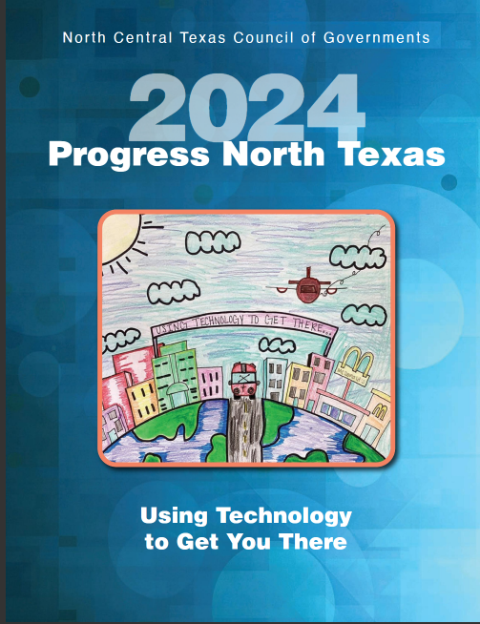
Progress North Texas
Purpose:
Annual report, summarizing transportation system performance, recent accomplishments and next steps for transportation plans, projects and policies.
Key Takeaways:
Progress on freight items such as Truck Travel Time Reliability, NT Moves, At Grade Crossing Incidents and the Freight Safety Initiative are highlighted.
Published in early June 2024.
Link- North Central Texas Council of Governments - Progress North Texas (nctcog.org)

Slide 4
NT MOVES – Double Track Projects
Project Overview:
Collaborative effort between NCTCOG, DART, TM, and TRE to increase regional freight and passenger mobility. Partially funded by a BUILD grant.
Projects:
Double Track Medical Market Center to Stemmons Freeway
Double Track Handley Ederville Road to Precinct Line Road
NCTCOG Freight Planning Program

Slide 5
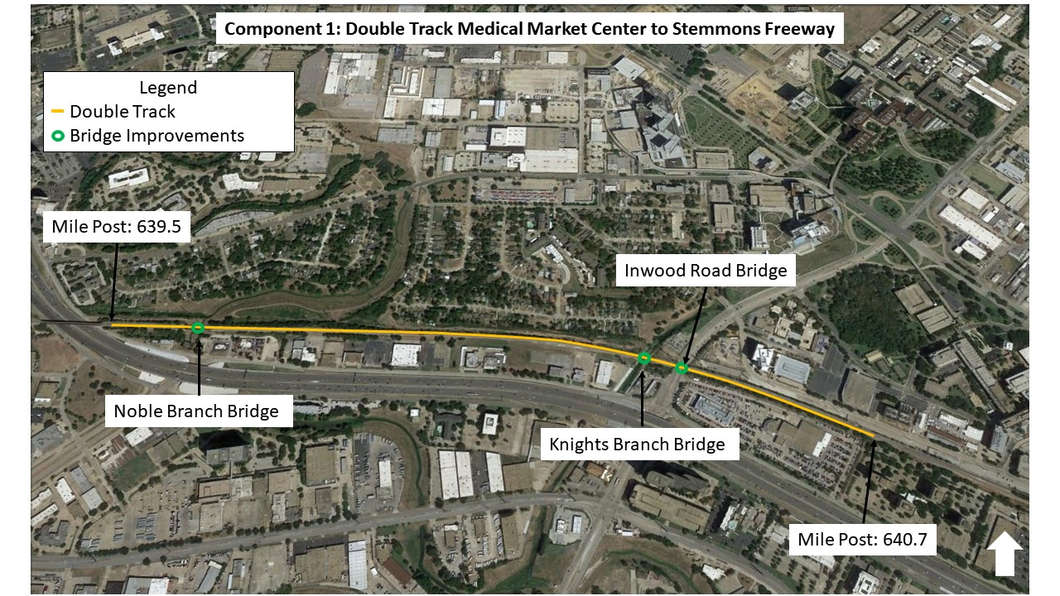
NT MOVES – Double Track Project Updates
Project Overview:
Both double tracking projects have entered final design.
Both projects will begin construction in the spring of 2025.
NCTCOG Freight Planning Program

Slide 6

Regional Rail Information System (RRIS)
Purpose:
To maximize efficiency on freight and passenger rail networks by enabling participating rail agencies to exchange timely, accurate, and actionable info on train movements in the region.
How it helps:
Addresses constraints
Improve freight rail mobility and reliability
Finds opportunities to add new freight and passenger rail service
Improve rail forecast modeling

Slide 7
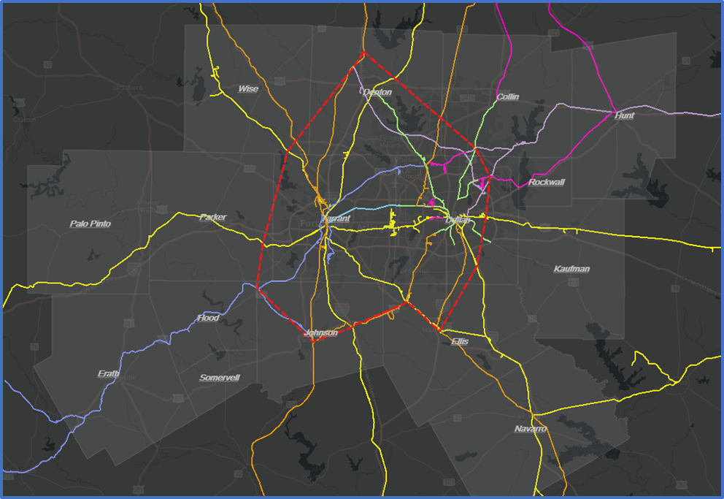
Clear Path Technology
Project Overview
Working with Railinc to develop this technology
In use in the Greater Chicago Area
Technology-based innovative response to maximizing efficiency on shared use freight and passenger rail networks
Will enable all rail agencies to exchange timely, accurate, and actionable information on train movements in the region
Courtesy of Railinc
NCTCOG Freight Planning Program

Slide 8
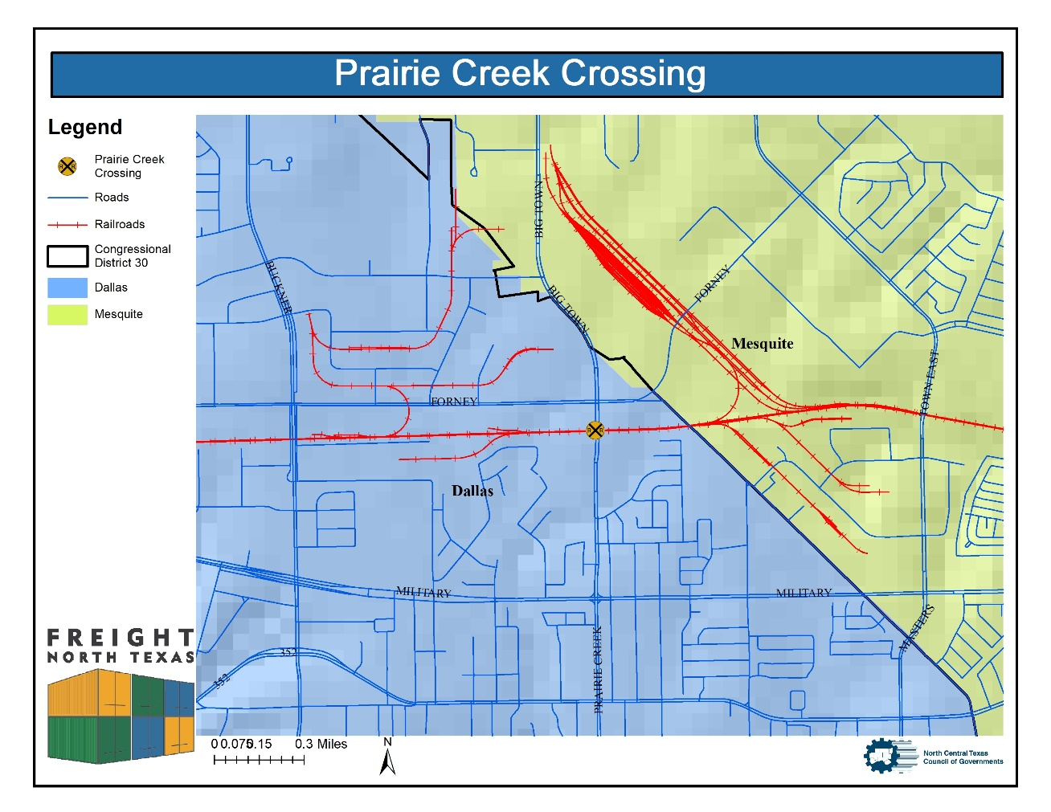
Grant Efforts
Overview:
Assisting with various grants including the INFRA Grant and Railroad Crossing Elimination Grants (RCEP).
Upcoming Grants:
RCEP – Notice of Funding Opportunity is expected later this month.
Potential RCEP Projects
Prairie Creek Road
Bonds Ranch Road
Ennis Avenue

Slide 9
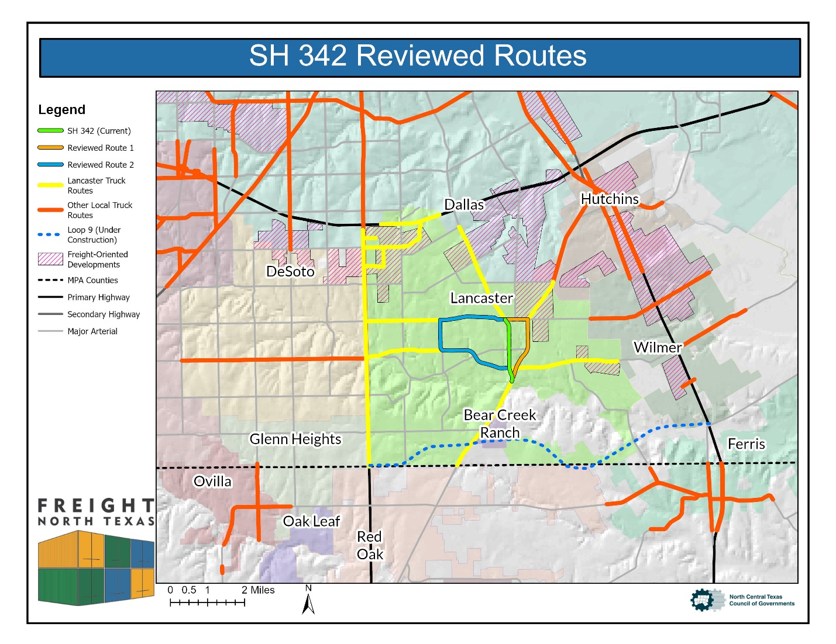
Corridor Studies
Overview:
To analyze or review a specific freight related issue at a corridor, neighborhood or city level
Recent studies:
City of Glen Rose Downtown Analysis
Lancaster Truck Route Study Phase II
City of Dallas Fair Park Links
At Grade Crossing Studies

Slide 10
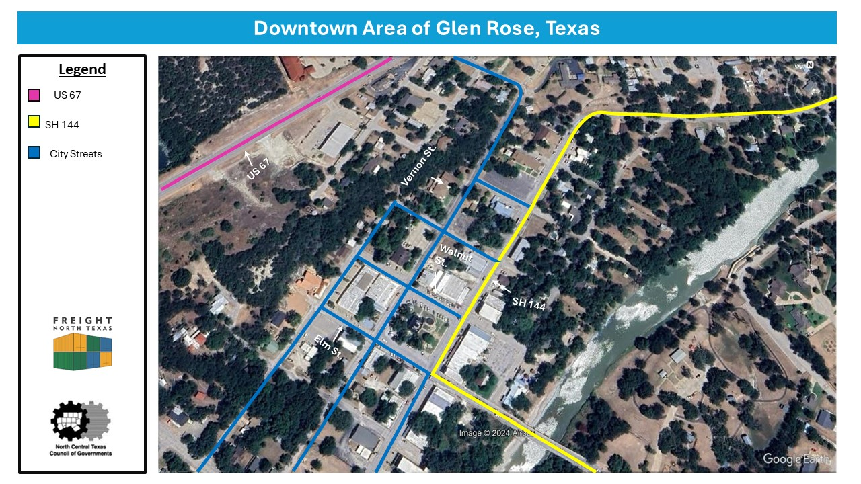
City of Glen Rose Downtown Analysis
Overview:
NCTCOG has conducted an analysis of truck movements through the downtown area.
This analysis includes a review of the truck traffic patterns, road conditions, and safety of the downtown area of Glen Rose.

Slide 11
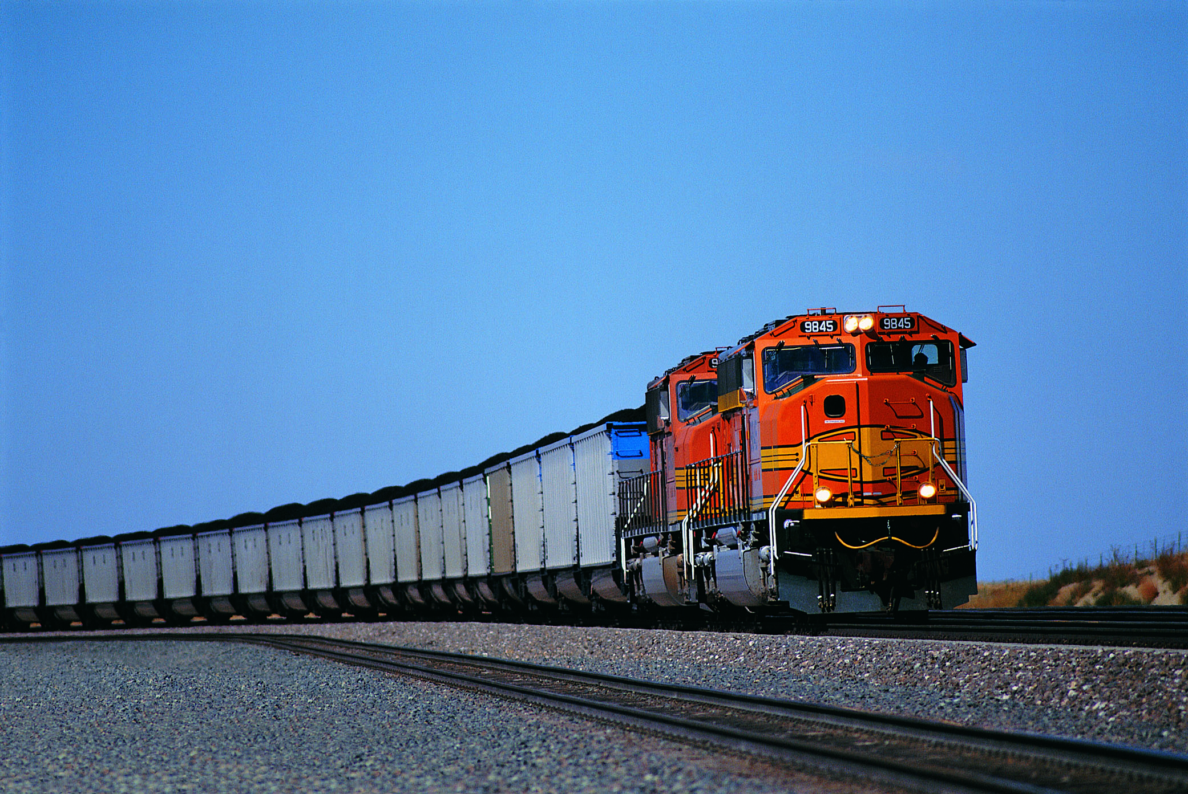
Rail Studies
Overview:
To analyze or review a specific rail related issue at a corridor, neighborhood or city level
Recent studies:
Victory Station Pedestrian Crossing
City of Fort Worth Crossing Analysis
Starting on City of Dallas Crossing Analysis

Slide 12

Impact of Rail Crossings
Overview:
Rail crossings are an important concern across the region.
Safety is always NCTCOG’s top priority
Blocked crossings cause safety issues and traffic concerns for drivers
The Freight Team will continue their efforts in outreach, education, analysis, and reviews of rail crossings to ensure safety.

Slide 13
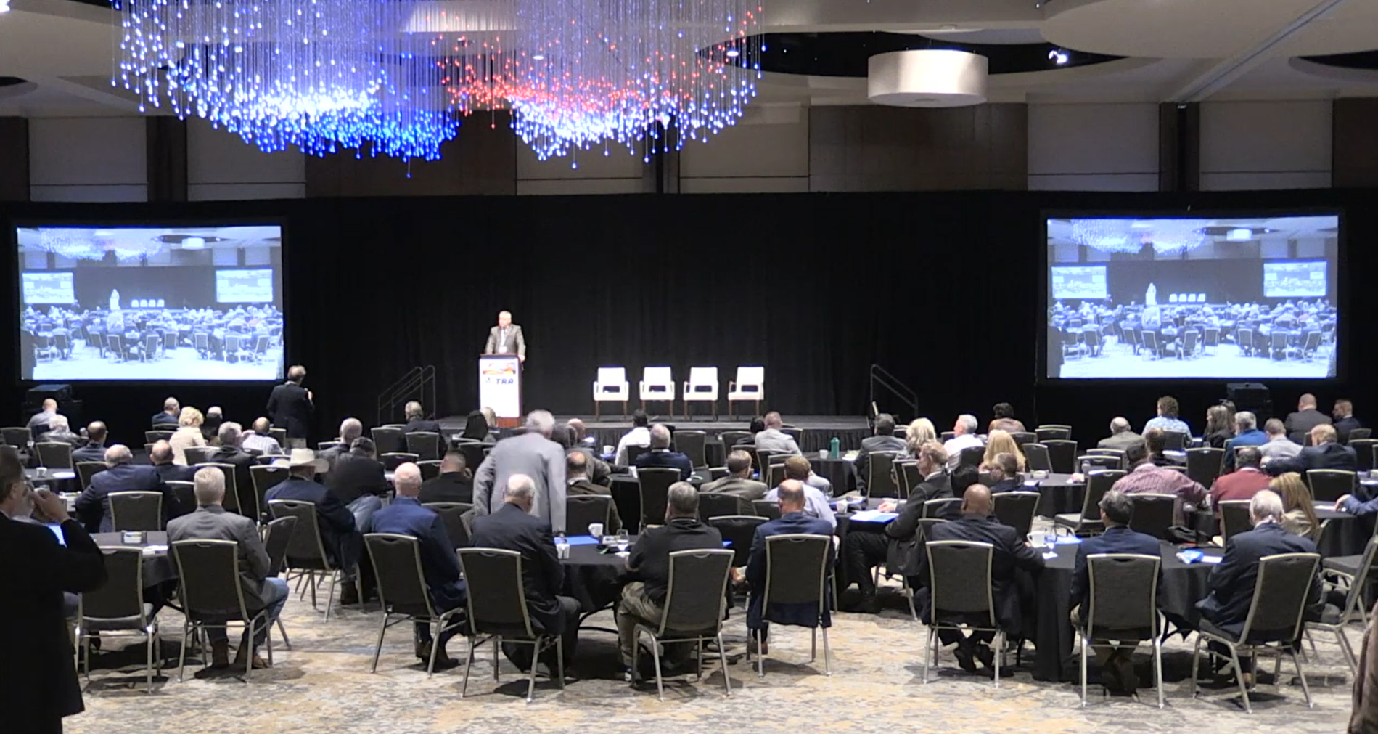
Education and Outreach
Freight Safety Initiative 2025:
To create a safer environment for freight and passenger movements through physical improvements and safety awareness initiatives. Last completed in 2023.
Recent Outreach Events:
Southwestern Rail Conference
Inland Port Symposium (DCCCD Cedar Valley)
Fair Park Links Public Meeting
Source: Texas Rail Advocates

Slide 14
Questions

Slide 15

CONTACT US
Savannah Briscoe
Transportation Planner
sbriscoe@nctcog.org | 817- 608-2347
Jeff Hathcock
Program Manager
jhathcock@nctcog.org | 817-608-2354
Mike Johnson
Principal Transportation Planner
mjohnson@nctcog.org | 817-695-9160

