Slide 1
Integrated Stormwater Management (iSWM) Implementation
Subcommittee Meeting
Staff Planner: Casey Cannon & Carl Singleton
October 9, 2024

Slide 2
Welcome!
iSWM Implementation Subcommittee
Wednesday, October 9, 2024
1:30 p.m. to 3:30 p.m., In-Person Meeting
NCTCOG Offices, Centerpoint II, (1st Floor) Regional Forum Room
616 Six Flags Drive, Arlington, Texas 76011

Slide 3
Agenda
Welcome and Introductions
Action Items
  I. Approval of July 24, 2024, Meeting Summary. The meeting summary will be presented to the Subcommittee for approval.
Discussion Items
  I. FY25 Work Program Update. NCTCOG & Halff Associates will provide an update on FY25 Tasks.
  II. iSWM Standard In-Comparison to Public Works Standard Drawings. NCTCOG will present comparison of iSWM Standards & Public Works Standard Drawings for update in FY25.
Information Items
  I. Regional Public Works Program Update. NCTCOG will provide an update on the FY25 Regional Public Works Program.
  II. NCTCOG will provide an update for the FY25 TMDL Program.
  III. General Information Items & Roundtable Discussion.
  IV. Schedule for the Next Meeting. The next meeting is scheduled for January 8, 2025, in-person at the NCTCOG Offices.
Adjournment

Slide 4
Approval of July 24, 2024, Meeting Summary
Copies of the meeting summary are available for review with the meeting materials for today.
The meeting summary is posted online for future reference.

Slide 5

Discussion Items

Slide 6
FY25 Work Program Update

Slide 7
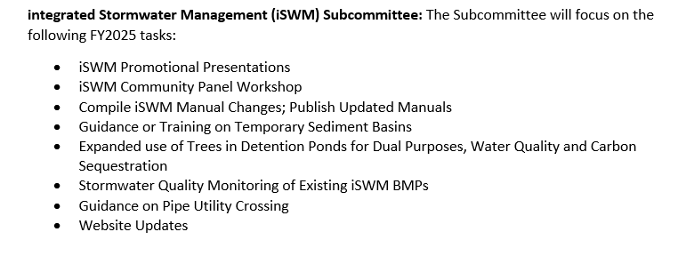
FY25 Work Program Update
Task Deliverables for FY25:

Slide 8
NCTCOG iSWM Task Order Updates
October 9th, 2024

Slide 9
Task Order 2.1 Progress
Task 1 - As-Needed Support Services
Task 2 - Development Submittal and Review Process Training
Task 3 – iSWM Implementation Guidance Panel
Task 4 - Research Cumulative Impacts on Small Footprint Developments
Task 5 - Engineering Best Practices for iSWM Submittals
iSWM Task Order Updates | 9

Slide 10
Task Order 2.1 Progress
Task 2 – Development Submittal and Review Process Training
  Has been completed
  Approximately 40 attendees, in-person and virtual
  Recording/slides to be delivered to NCTCOG
Task 5 – Summary Memo
  In progress, to be finalized shortly
iSWM Task Order Updates | 10

Slide 11
Task Order 2.1 Progress
Task 3: iSWM Implementation Guidance Panel
  Also included in Task Order 2.2
  To be discussed:
    pros and cons of working with the iSWM program
    what works and what doesn’t work.
  Participants will include Denton and Mansfield
  NCTCOG to reach out to other potential presenters
  Expected Date: January-February 2025
iSWM Task Order Updates | 11

Slide 12
Task Order 2.1 Progress
Task 4: Research “Cumulative Impacts” on Small Footprint Developments
  City of Fort Worth’s Linwood area XPSWMM model as basis for study
  Modeled multiple increased impervious scenarios for parcels zoned as A-5, A-10, B
  Analysis of increased runoff and flooding impacts in selected sub-watersheds
iSWM Task Order Updates | 12

Slide 13
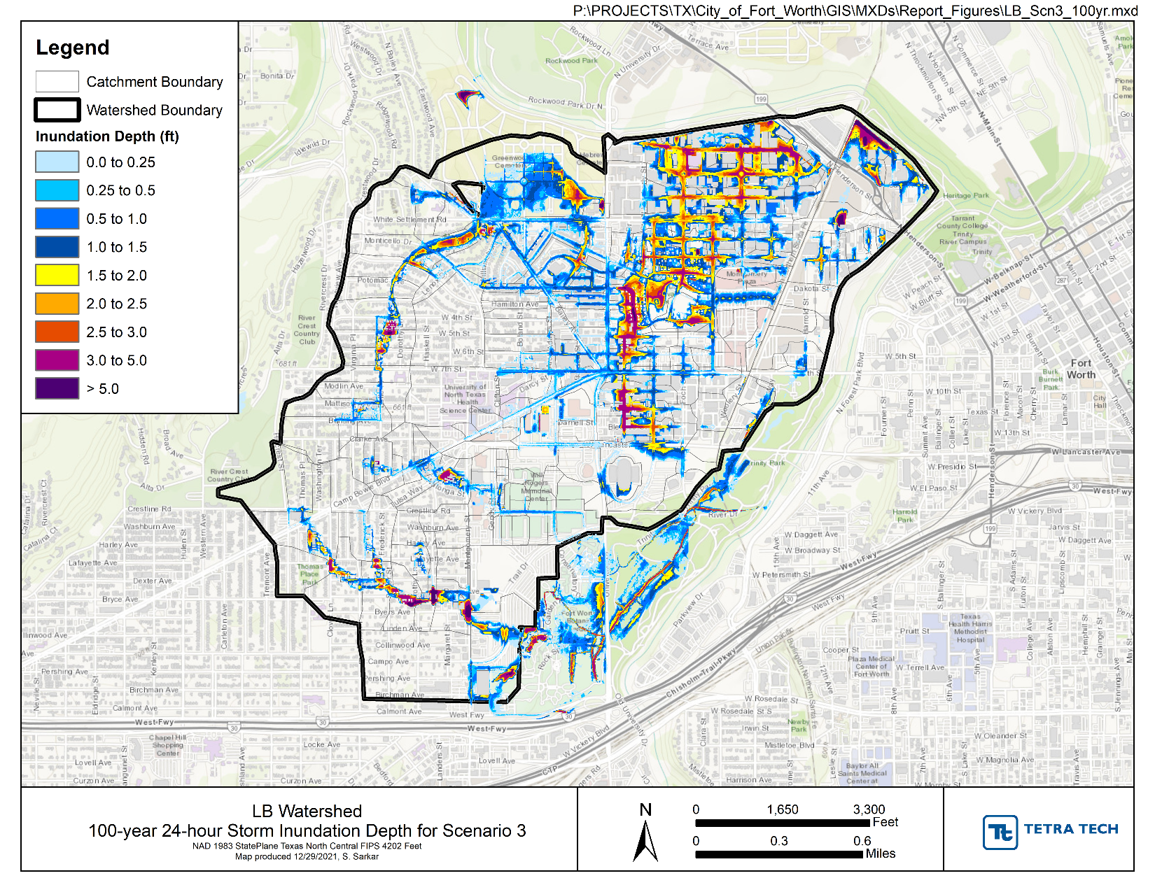
Task Order 2.1 Progress
Task 4: Research “Cumulative Impacts” on Small Footprint Developments
  City of Fort Worth’s Cumulative Impacts Study (2022)
  Key indicators suggested increased inundation and potential for more properties to be affected by flooding …
iSWM Task Order Updates | 13

Slide 14
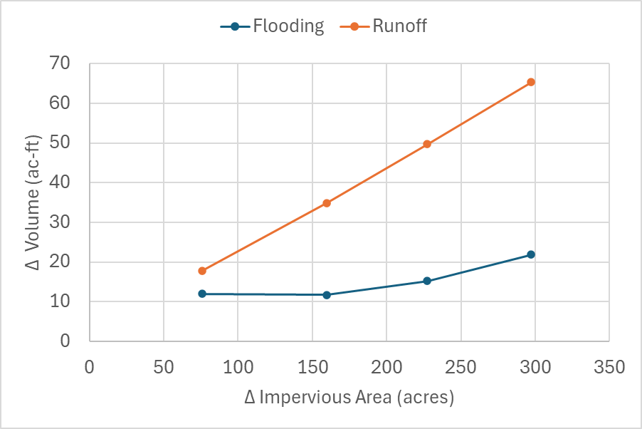
Task Order 2.1 Progress
Analysis Approach
  Progressively increase imperviousness
  Evaluate change in runoff and flooding
Δ Imperviousness (ac-ft) | Detention Depth (in)
75.9 | 7.7
159.8 | 15.1
227.4 | 21.6
297.2 | 28.3
iSWM Task Order Updates | 14

Slide 15
Task Order 2.2
Awaiting Task Order Authorization to Begin Work
  Project Management and Support Services
  iSWM Implementation Guidance for Communities in Region
  iSWM Promotional Presentations for Partnering Organizations
  Stormwater Quality Monitoring Program Development for Existing iSWM BMPs
  Develop Technical Case Studies
  Website Updates
  Guidance or Training on Temporary Sediment Basins
  Guidance on Pipe Utility Crossings
  Expanded Use of Trees in Detention Ponds
iSWM Task Order Updates | 15

Slide 16
Task Order 2.2
Intention Behind Tasks/Suggestions
  Guidance on Pipe Utility Crossings
    BMPs to prevent erosion around pipe utility crossings over streams
  Stormwater Quality Monitoring of Existing iSWM BMPs
    Create plan for monitoring pollutant removal efficiency of several BMPs in North Texas area installed according to iSWM criteria
iSWM Task Order Updates | 16

Slide 17
Questions?

Slide 18
iSWM Standard In-Comparison to Public Works Standard Drawings

Slide 19
iSWM Standards in Technical Manuals
(Division 1000) Public Works Construction Standards & iSWM Construction Controls Standard Details (Comparison)
NCTCOG reviewed iSWM drawings to see whether:
A corresponding drawing occurred in newly amended Construction Standards
The content of a newer drawing was revised
iSWM drawings needing drawing/note revision described in following slides
All revisions are minor
Other comparable (but unchanged) drawings could include updated date

Slide 20
Standards In-Comparison
Subject/Item | iSWM Figure | Construction Standards Drawing | General Update Needed
1. Rock Check Dam | 2.1 (1 of 2) | 1060A | Both drawings; change in notes
2. Temporary Erosion Control Blankets | 2.7 (1 of 2, but will become 1 of 3) | 1200A | Both drawings
2. Notes on Temporary Erosion Control Blankets | 2.7 (2 of 2, but will become 3 of 3) | 1200C | Additional/revised notes
2. Temporary Erosion Control Blankets, Anchor Examples | 2.7 (will become 2 of 3) | 1200B | Not currently included in iSWM manual

Slide 21
Standards In-Comparison, cont.
Subject/Item | iSWM Figure | Construction Standards Drawing | General Update Needed
4. Filter Tube Curb Inlet Protection | 3.6 | 1140 | One drawing
5. Hog Wire Weir Curb Inlet Protection | 3.7 (1 of 2) | 1150A (Wire Weir Curb Inlet Protection) | Name
5. Hog Wire Weir Curb Inlet Protection | 3.7 (2 of 2) | 1150B (Wire Weir Curb Inlet Protection) | Name One table/text
6. Curb Rock Sock On-Grade Curb Inlet Protection | 3.9 (1 of 2) | 1160 | Two drawings
6. Curb Rock Sock On-Grade Curb Inlet Protection | 3.9 (2 of 2) | 1160 | Can be removed; notes can be incorporated into drawing as in Construction Standards

Slide 22
Standards In-Comparison, cont.
Subject/Item | iSWM Figure | Construction Standards Drawing | General Update Needed
7. Filter Tube Area Inlet Protection | 3.13 | 1170 | Four drawings
8. Sediment Basin with Overflow Riser | 3.20 | 1120 | One drawing; add notes
9. Silt Fence | 3.28 (1 of 2) | 1020A | One drawing
10. Stabilized Construction Exit | 3.29 (1 of 2) | 1070A | Language change
10. Stabilized Construction Exit | 3.29 (2 of 2) | 1070B | Language changes

Slide 23
Standards In-Comparison, cont.
Subject/Item | iSWM Figure | Construction Standards Drawing | General Update Needed
11. Temporary Erosion Control Blankets | Does this duplicate iSWM item #2, Figures 2.7 (1-3)?
12. Turf Reinforcement Mats | 2.11 (2 of 3) | 1210B (Permanent Turf Reinforcement Mats) | One drawing
13. Temporary Velocity Dissipation Devise | 2.13 | 1220 (Velocity Dissipation Device) | Remove asterisk
15. Excavated Inlet Protection | 3.11 | 1180 (Area Inlet Protection Excavated Impoundment) | Two drawings

Slide 24
Standards In-Comparison, cont.
Subject/Item | iSWM Figure | Construction Standards Drawing | General Update Needed
16. Excavated Stone Outlet Sediment Trap | 3.30 (2 of 2) | 1100B | Both drawings; add notes
18. Grouted Rock Rip-Rap Detail | x.xx (1 of 2) | 1250A (Grouted Rock Rip Rap) | Both drawings; add note
19. Trash Screen/Catch Detail | x.xx (2 of 2) | 1260 (Temporary Trash Screen) | Add note
20. Trash Rack | x.xx (Plan) | 1270B (Multiple Outlet Trash Screen Basket System) | Add note

Slide 25

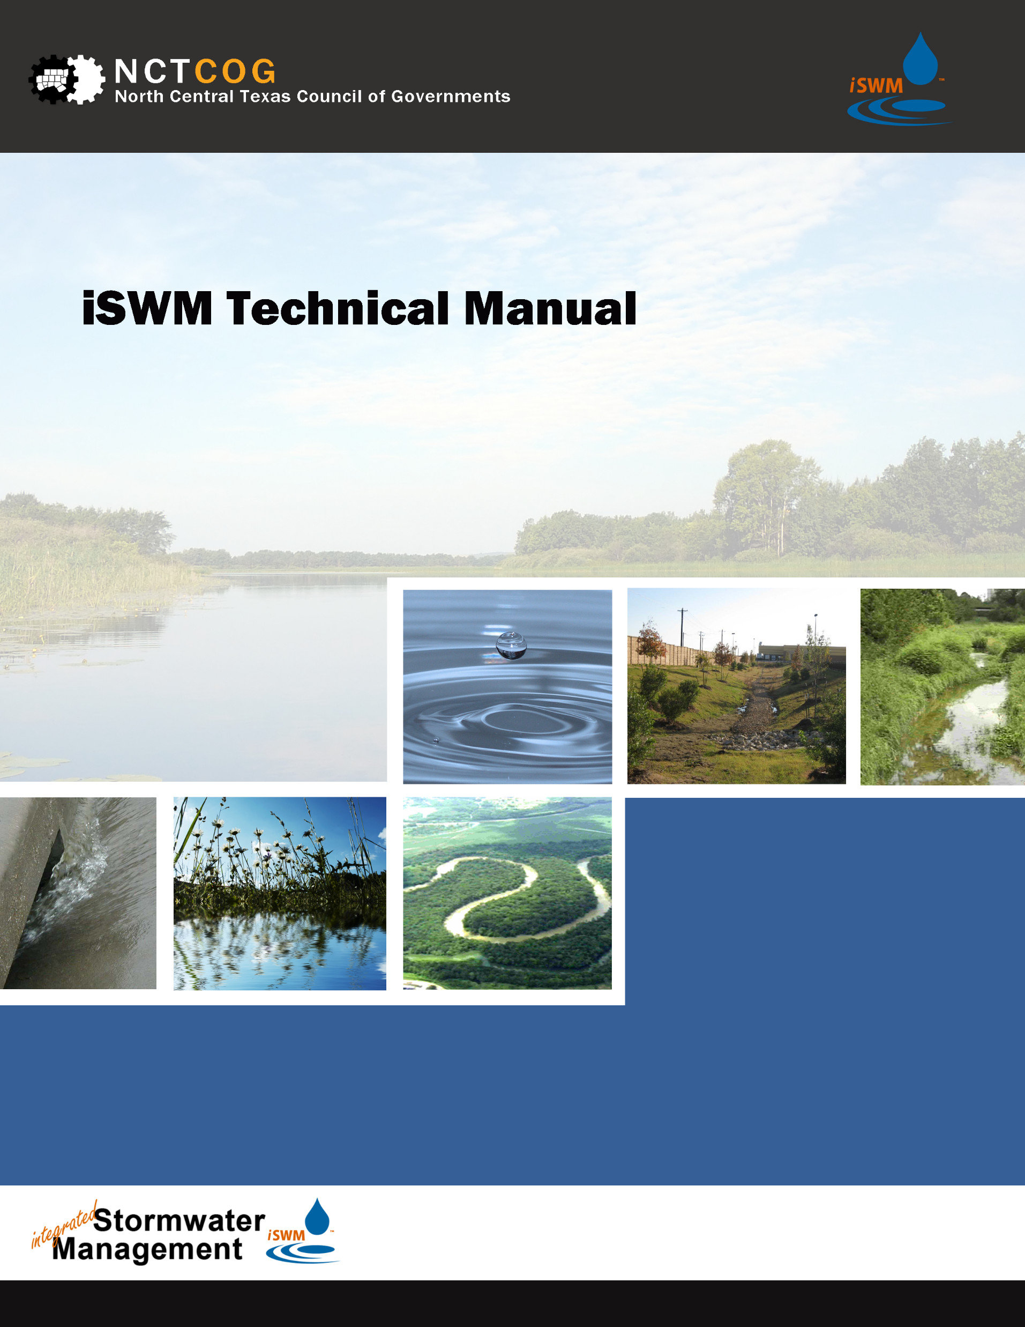
Standards In-Comparison
Are there additional drawings from Construction Standards that correlate with iSWM drawings and should be added?

Slide 26

Information Items

Slide 27
Public Works Program Update
Virtual Sustainable Public Rights of Way Subcommittee (SPROW) meeting, November 13, 2024
https://www.nctcog.org/envir/committees/public-works-council/sustainable-public-rights-of-way-subcommittee
In Person Public Works Council (PWC) meeting, November 21, 2024, www.nctcog.org/envir/committees/public-works-council
Save the date for the 26th Annual Public Works Roundup, September 4, 2025, Hurst Conference Center https://www.nctcog.org/envir/public-works/annual-public-works-roundup
For more information on the Public Works program, please
contact Carl Singleton at csingleton@nctcog.org or (817) 458-4768

Slide 28
NCTCOG TMDL Program Update
Joint TMDL Stormwater & Wastewater Subcommittee Meeting
  Next Joint Stormwater and Wastewater Technical Subcommittee meeting is tentatively scheduled for December 2024 via Microsoft Teams.
  More information available online.
Upper Trinity River Basin Coordinating Committee
  Next UTRB-CC meeting is (In-person) tentatively scheduled for February 2025. The location for this meeting is to be determined.
  More information available online.
For more information on the TMDL program please
contact Hannah Ordonez at hordonez@nctcog.org or (817) 695-9215

Slide 29
Upcoming Events, Conferences, and Opportunities
TFMA 2025 Annual Meeting
  Denton, TX
  March 25 – 28, 2025
  More information available online.

Slide 30
Upcoming NCTCOG Meetings
Regional Stormwater Management Coordinating Council, November 12, 2024
Public Works Council, November 21, 2024
Next iSWM Meeting: January 29, 2025, at 1:30 PM
Environment & Development Committees Information
Available at nctcog.org/envir/committees

Slide 31
Upcoming iSWM Agenda Topics
Special Presentation Ideas for next meeting (virtual)?

Slide 32

Roundtable Discussion

Slide 33






Contact & Connect
Casey Cannon
Environment & Development Planner
North Central Texas Council of Governments
ccannon@nctcog.org
817.608.2313
iswm.nctcog.org
facebook.com/nctcogenv
Carl Singleton
Environment & Development Planner
North Central Texas Council of Governments
csingleton@nctcog.org
817.458.4768
@nctcogenv
@nctcogenv
Kate Zielke
Environment and Development Program Supervisor
North Central Texas Council of Governments
kzielke@nctcog.org
817.695.9227
youtube.com/user/nctcoged
EandD@nctcog.org

