Slide 1
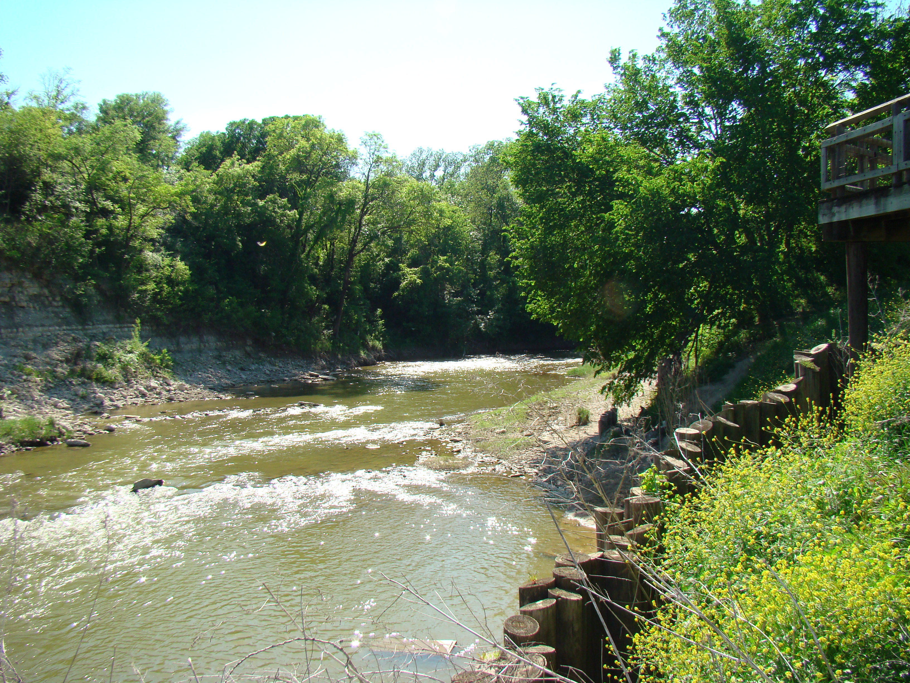
Pollution Prevention (P2) Task Force
October 3, 2018
Staff Contact: Kathleen Myers

Slide 2

Regulatory Updates
Renewal of the Small (Phase II) Municipal Separate Storm Sewer System (MS4) General Permit, TXR040000
  Publish notice: Aug. 24, 2018
  ➢ Texas Register
  ➢ 14 newspapers across the state
  ➢ 30-Day comment period: Aug. 24 – Sept. 24, 2018
  ➢ Public meeting: Sept. 24, 2018
  Currently: Reviewing and working on response to comments
  ➢ Commissioners Agenda (tentative): Dec. 12, 2018
  “Approximately 5 months behind” - Rebecca Villalba, TCEQ, TX Stormwater Conference September 26, 2018
Notes:
To elaborate, with an update from the Trade Fair
Ask group their plans for SWMP update
Water Quality Advisory Group Meeting Update January 31, 20198
Completed ROC, sent to upper management Nov 7th including draft permit and fact sheet, scheduled to go to commissioners agenda february 7th; do have proposed everying up on commissioners agenda webpage now.
Reviewed process up to date; edited and revised and sent to EPA for review; received an objection from EPA (they were hoping this wouldn’t happen); they have been struggling with figuring out how to deal with their comments; Dec 14th held conf call with EPA; 3 conf calls so far; first comment - don’t believe permit is clear specific and measurable in terms of meeting the requirements of the MS4 Remand Rule (TCEQ said they did their best, TCEQ is pushing back on this. 2 - EPA feels we extended deadlines for certain items that MS4 should have already met, so TCEQ is tweaking this language; 3- Regarding public notification for NOC - right now the process is we don’t go through public notice period anymore, but EPA said even those changes are considered a modifiction and a 30day comment period is necessary, but TCEQ; TCEQ is claiming we already provide more notification and transparency then other states;
If we don’t reach an agreeemtn in the next month or so, it will delay the timeline probably.

Slide 3
Regulatory Updates
  Summary of Proposed Changes to Existing Permit
  ➢ Phase II MS4 Remand Rule
    • Modified permit language to be clear, specific and
    measurable
    • Added language regarding SWMP modifications during the permit term to comply with permit modification regulations at 40 CFR §§122.62 or 122.63
  ➢ Electronic Reporting Rule
    • Electronic submittal of applications and reports by December 21, 2020
Notes:
To elaborate, with an update from the Trade Fair
Ask group their plans for SWMP update
Water Quality Advisory Group Meeting Update January 31, 20198
Completed ROC, sent to upper management Nov 7th including draft permit and fact sheet, scheduled to go to commissioners agenda february 7th; do have proposed everying up on commissioners agenda webpage now.
Reviewed process up to date; edited and revised and sent to EPA for review; received an objection from EPA (they were hoping this wouldn’t happen); they have been struggling with figuring out how to deal with their comments; Dec 14th held conf call with EPA; 3 conf calls so far; first comment - don’t believe permit is clear specific and measurable in terms of meeting the requirements of the MS4 Remand Rule (TCEQ said they did their best, TCEQ is pushing back on this. 2 - EPA feels we extended deadlines for certain items that MS4 should have already met, so TCEQ is tweaking this language; 3- Regarding public notification for NOC - right now the process is we don’t go through public notice period anymore, but EPA said even those changes are considered a modifiction and a 30day comment period is necessary, but TCEQ; TCEQ is claiming we already provide more notification and transparency then other states;
If we don’t reach an agreeemtn in the next month or so, it will delay the timeline probably.

Slide 4
Regulatory Updates
  Summary of Proposed Changes to Existing Permit
  ➢ Added and revised definitions such as benchmark value, infeasible, construction activity, Waters of the US, and impaired waterbodies
  ➢ Clarified that annexation of lands or acquiring new areas – will not require an NOC, but will require:
    • Within 90 days have a plan for implementing the SWMP in new
    areas
    • Implement program in new areas as expeditiously as practicable
    but no later than three years
  ➢ Added a requirement to check annually if a water body within the MS4’s permitted area has been added to the latest CWA 305(b)/303(d) list.
    • Newly listed impaired waterbodies must be addressed in the
    SWMP within two years.
  ➢ MCM 7. Construction Activities where the MS4 is the site operator
    • Decreased the benchmark value of total suspended solids from
    100 mg/L to 50 mg/L to be consistent with the 2016 MSGP
  ➢ Application fee increased from $100 to $400
Notes:
To elaborate, with an update from the Trade Fair
Ask group their plans for SWMP update
Water Quality Advisory Group Meeting Update January 31, 20198
Completed ROC, sent to upper management Nov 7th including draft permit and fact sheet, scheduled to go to commissioners agenda february 7th; do have proposed everying up on commissioners agenda webpage now.
Reviewed process up to date; edited and revised and sent to EPA for review; received an objection from EPA (they were hoping this wouldn’t happen); they have been struggling with figuring out how to deal with their comments; Dec 14th held conf call with EPA; 3 conf calls so far; first comment - don’t believe permit is clear specific and measurable in terms of meeting the requirements of the MS4 Remand Rule (TCEQ said they did their best, TCEQ is pushing back on this. 2 - EPA feels we extended deadlines for certain items that MS4 should have already met, so TCEQ is tweaking this language; 3- Regarding public notification for NOC - right now the process is we don’t go through public notice period anymore, but EPA said even those changes are considered a modifiction and a 30day comment period is necessary, but TCEQ; TCEQ is claiming we already provide more notification and transparency then other states;
If we don’t reach an agreeemtn in the next month or so, it will delay the timeline probably.

Slide 5
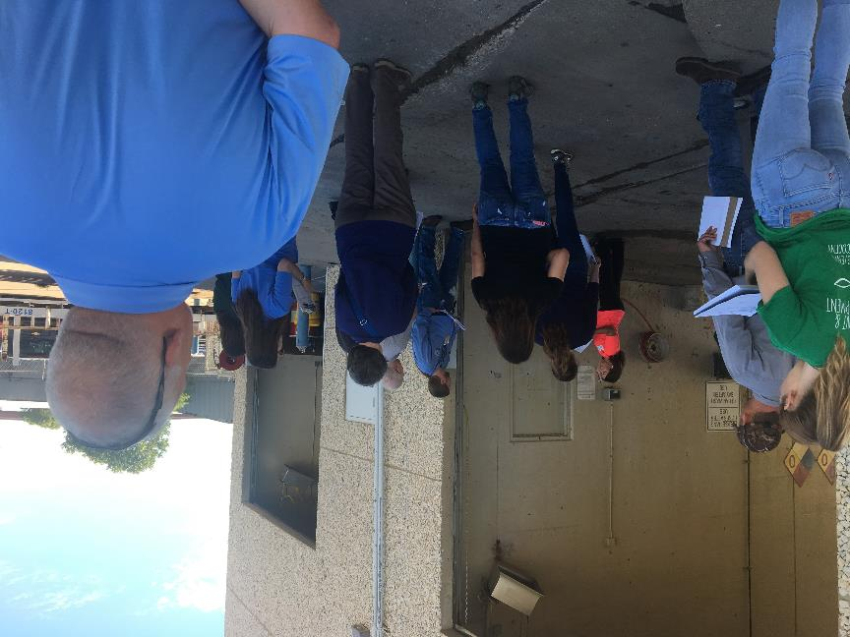
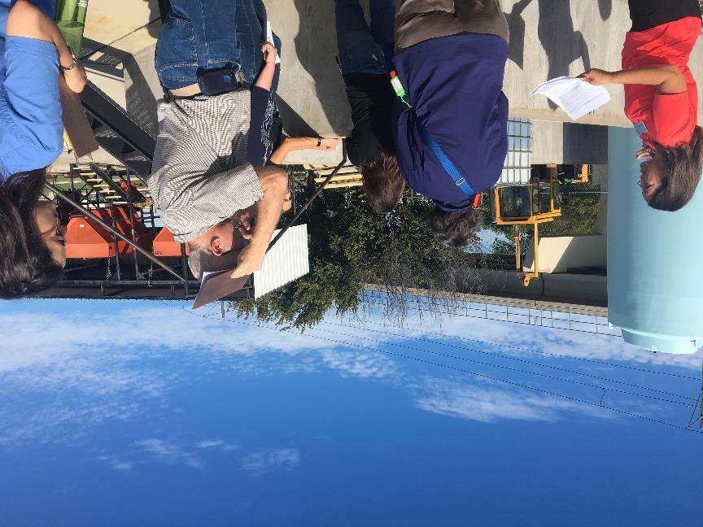
Mock Inspection
Took place in Carrollton on September 20th at the Central Service Center
Special thanks to Krista Pender for hosting and leading

Slide 6
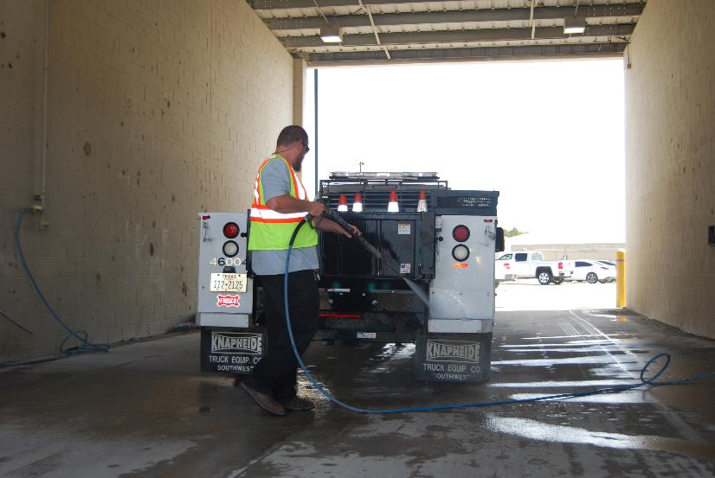
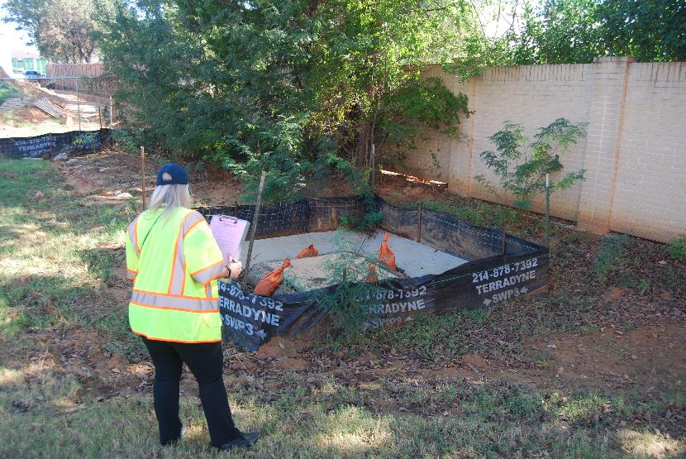
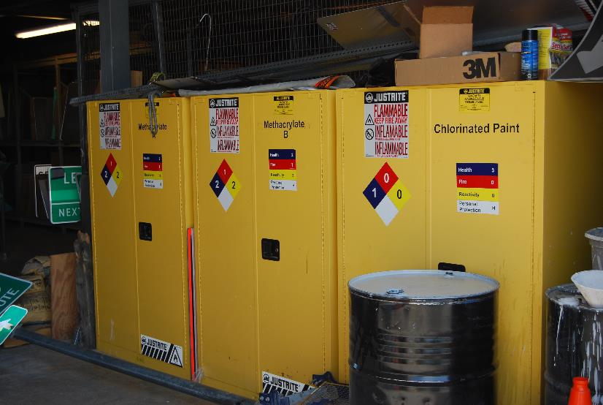
Training Videos
NCTCOG staff is assembling the final product
We will notify you if additional footage is needed

Slide 7

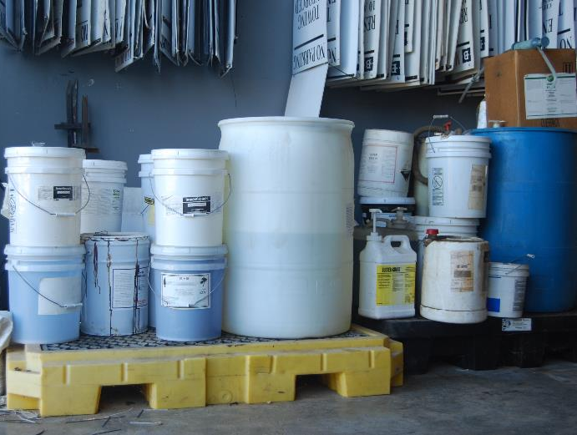
Upcoming Projects
Online Training Modules
NCTCOG staff will turn 1 or 2 of the video segments into an online training module
Will be similar to the SSO and Potable Water Discharge modules
Prioritized Segments are:
  Streets and Drainage Maintenance
  Fleet Maintenance and Material Handling
Conversion of video segments will probably continue as the next FY project. Next priority is:
  Construction Activities and Land Disturbance

Slide 8
P2 Resources Reminder
Self Audit Guidebook
Pollution Prevention BMP Posters
Compilation of SOPs
Training Videos and Modules
  Train the trainer materials
www.nctcog.org/envir/watershed-management/stormwater/pollution-prevention

Slide 9
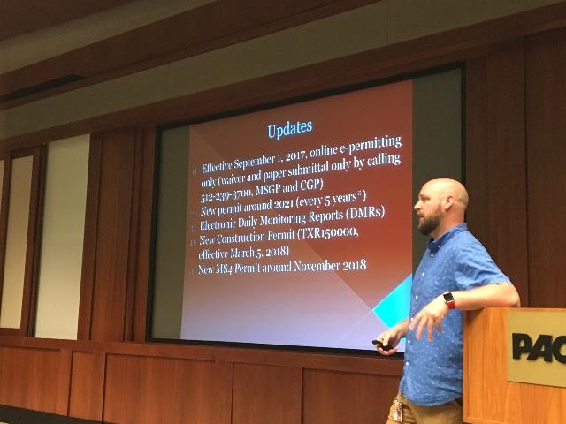
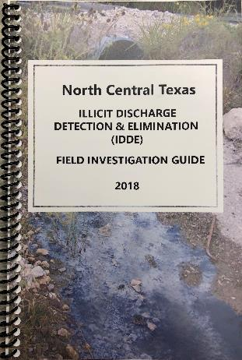

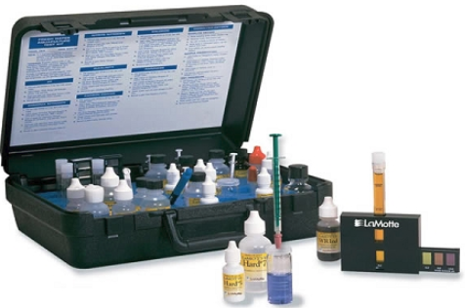
IDDE Updates
IDDE Field Guide
The updated 2018 IDDE Field Guide is now available. Communities who committed to participate in RSWMCC in FY18 receive 1 free copy; additional copies are $25.
The Industrial Inspectors Workshop took place April 6th at the Peterbilt facility in Denton. Guest speakers from TCEQ, City of Arlington, and City of Frisco attended, and Jeff Shiflet from City of Irving let the mock inspection. Peterbilt was a great partner and has offered to host future trainings.
Dry Weather Field Screening Training was held June 27th. Thank you to the City of Carrollton who hosted and the City of Arlington for conducting the training.

Slide 10
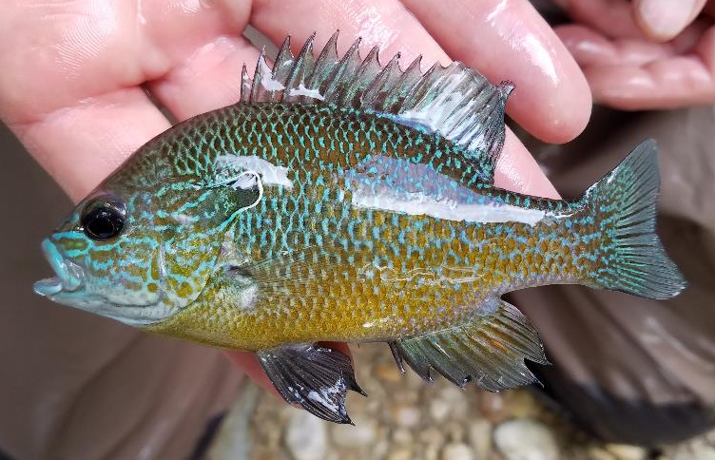
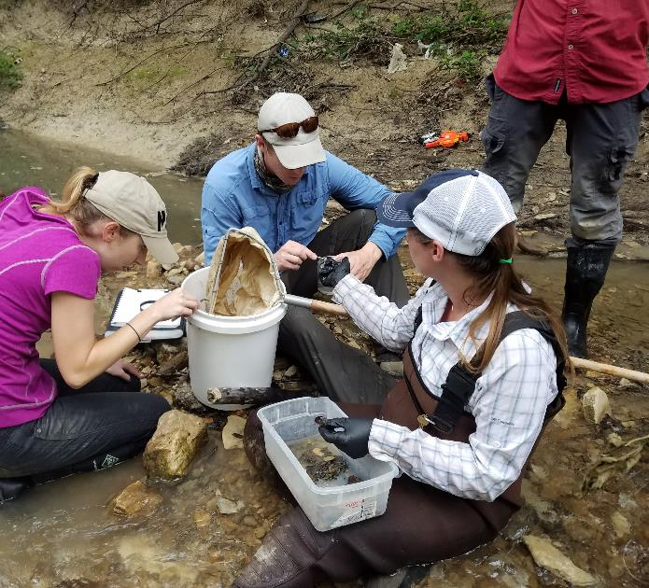
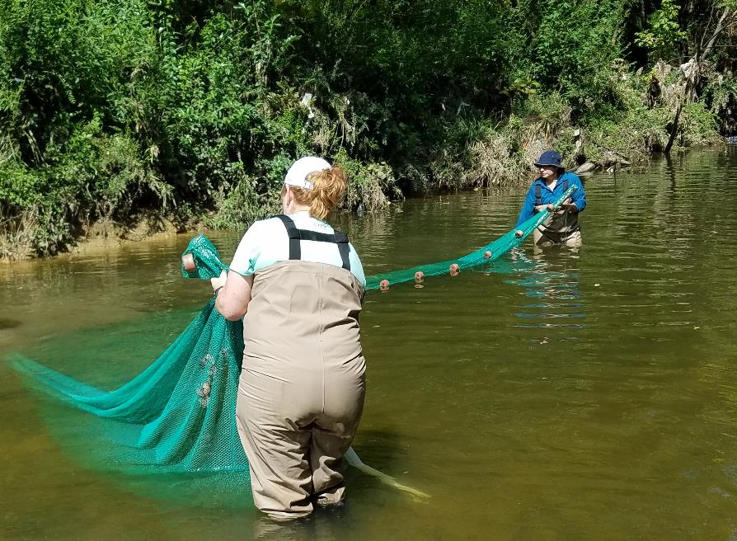
Stormwater Monitoring Update
Conducted bio-assessments in Garland, Irving, and Plano
Wet Weather Monitoring is ongoing
Data available in October
Notes:
Lead contractor, Atkins, held a project meeting and training on May 10th to discuss tasks, methodologies, troubleshooting, communications, hazards, and other general procedures. The team consists of a total of 16 people from Atkins, and subcontractors Freeze & Nichols and DSE. That doesn’t include the Lab that analyzes the samples.
After the meeting the COG met up with Freeze & Nichols to conduct site assessments for the Plano bio-monitoring sites. After spending a few hours with them, we can say that really appreciate the things that they do (waist high poison ivy and climbing down 30 degree embankments).
Sampling equipment was sent to manufacturer for repair. Will begin sampling next month.
Atkins is currently drafting a stormwater BMP analysis plan that will analyze the effectiveness of stormwater BMPs in correlation with the wet weather monitoring data collected.

Slide 11

Other NCTCOG Programs
Green infrastructure
Low Impact Development
Local project examples and case studies needed!
www.iswm.nctcog.org

Slide 12

Roundtable Discussion
RSWMCC MEMBERS UPDATE
Notes:
Matthew Green – pool draining question; pool filter backwashing – in the past this could be runoff into the road/grass, now you have to hook up to sanitary sewer; Plano considers this a point source discharge; Have other cities heard complaints about citizens reporting as complaints about citizens continuing to cause runoff and how do cities address this?

Slide 13

Upcoming Events and Conferences
Texas Commission on Environmental Quality (TCEQ)
October 9 - 11, 2018
Austin, Texas
The Autumn Environmental Conference and Expo combines the former Advanced Air Permitting and Water Quality/Stormwater Seminars and includes a one-day Waste Classification Workshop. This event provides engineers, environmental managers, consultants, and the regulated community updates on permitting rules, requirements, issues, and regulations.

Slide 14


Slide 15

RSWMCC Meetings
UPCOMING MEETINGS
Pollution Prevention
TASK FORCE
October 3, 2018
4th Floor Conference Room
IDDE
TASK FORCE
December 20, 2018
William J. Pitstick Executive Board Room
PETF
TASK FORCE
October 24, 2018
4th Floor Conference Room
RSWMCC
November 14, 2018
9:30 AM
William J. Pitstick Executive Board Room

Slide 16


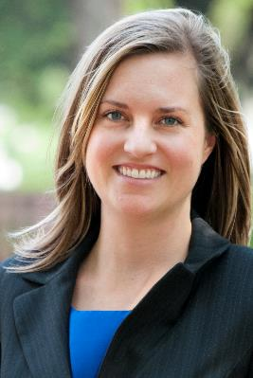



Stormwater Staff
Derica Peters
dpeters@nctcog.org
RSWMCC, iSWM
Cassidy Campbell
ccampbell@nctcog.org
TMDL, WATER
Mia Brown
mbbrown@nctcog.org
IDDE
Mayra Lopez
mlopez@nctcog.org
TMDL
Stormwater Monitoring
Kathleen Myers
kmyers@nctcog.org
PETF, P2, TMDL

